Slide 1
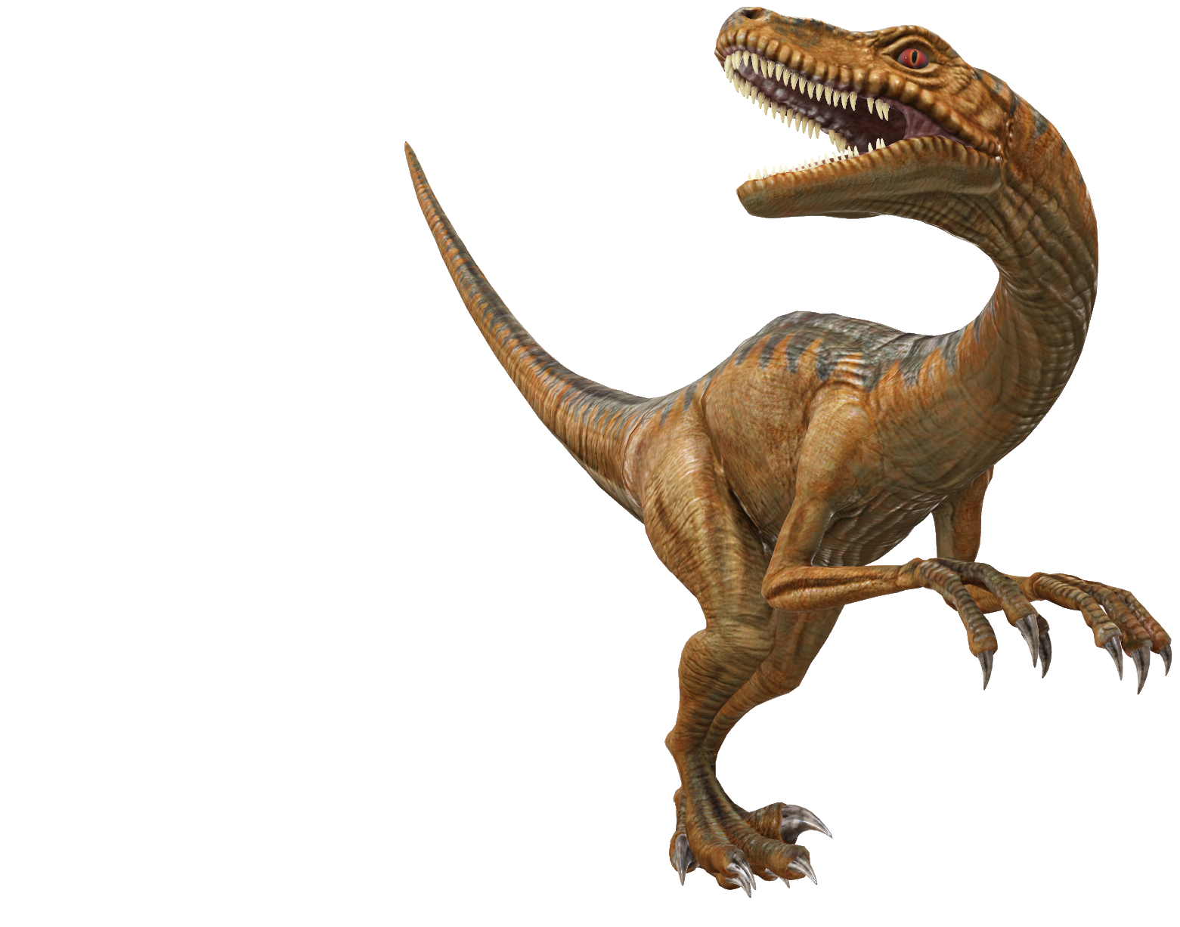
Unsupervised Graph Network Discrimination
CSE499A.5
Faculty: Mohammad Ashrafuzzaman Khan (Azk)
Done by:
Mahmud Elahi Akhter (1721498042)
Zahin Ahmed (1711020042)

Slide 2
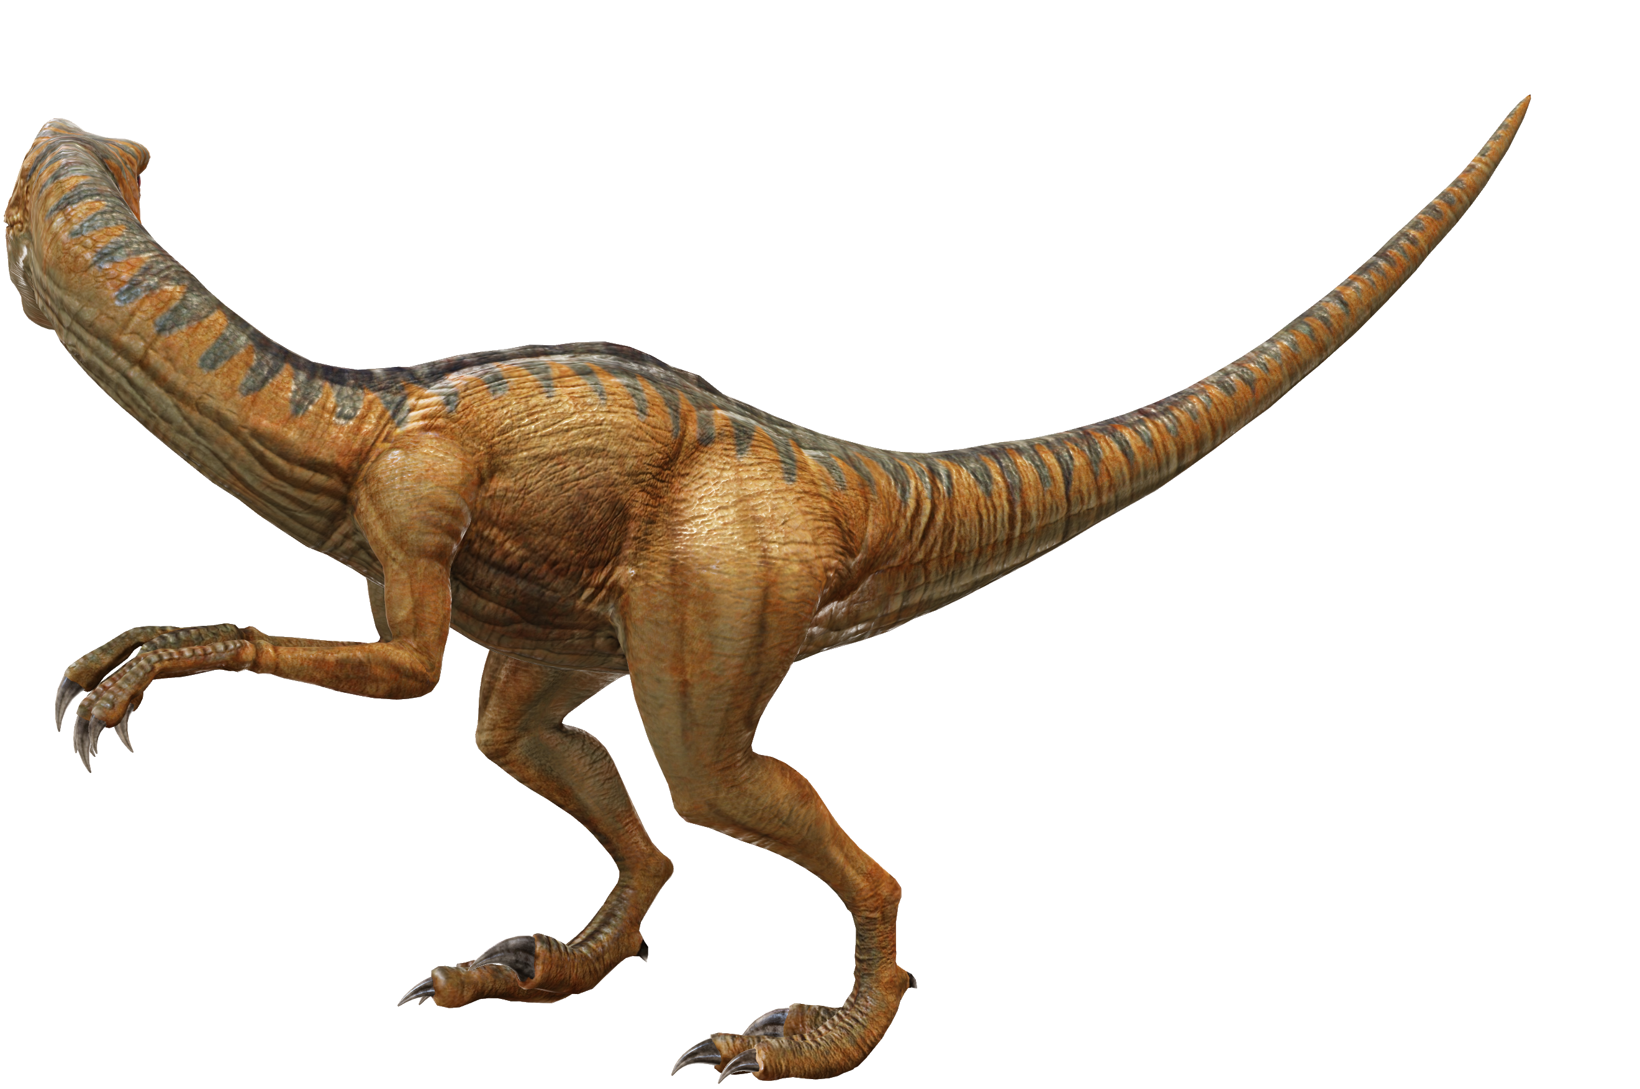
Introduction
Huge networks exist all around us
email communication
social media
e-commerce
Each network holds information regarding the behavior and characteristics of its members.
Extracting this information from known networks, might in turn help in identifying an unknown network.
Centrality values are usually used in analyzing a network

Slide 3
Hypothesis
It is possible to classify networks by applying Unsupervised Learning algorithms on the Centrality values of graphs.
If we can prove our alternative hypothesis, we will be able to identify /classify an unknown network.
If we prove the null hypothesis, we will be able to disprove many currently accepted works.

Slide 4
Procedure
Literature Review
Collection of usable networks (datasets)
Application of learning algorithms to all datasets
Selection of appropriate Unsupervised learning algorithms
Results Analysis
Selection of appropriate and calculable Centralities
Ablation Study

Slide 5
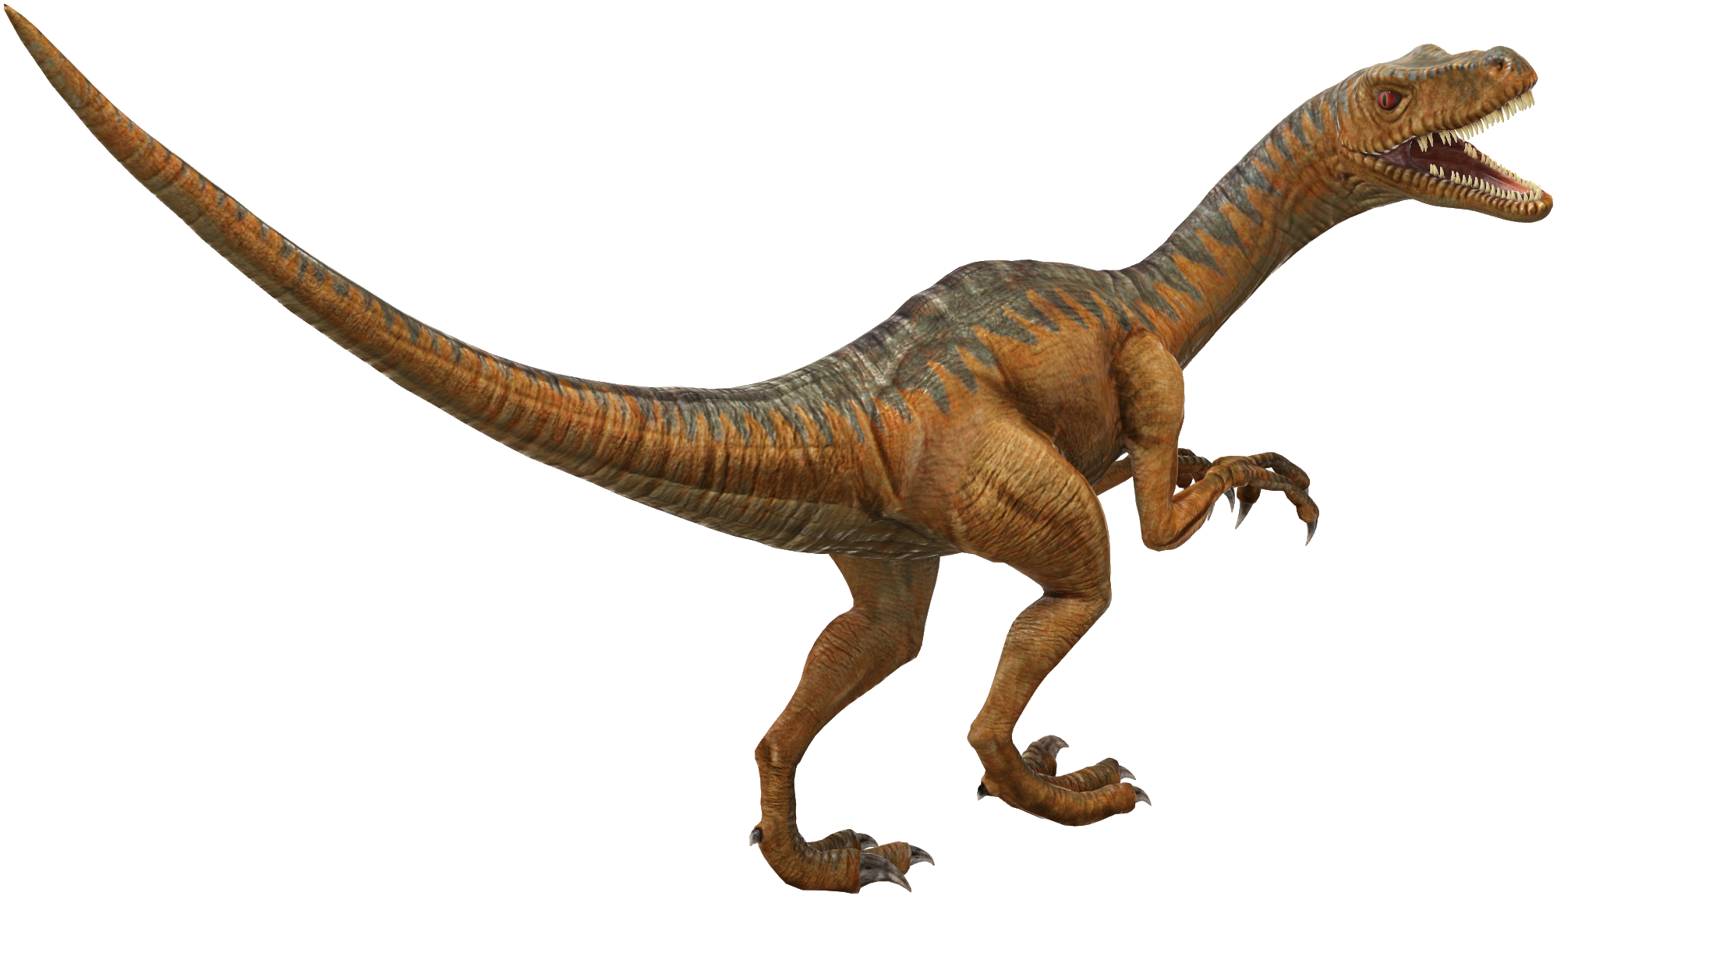
Literature Review
Use the text boxes displayed with a gray dotted outline to insert your content.

Slide 6
Literature Review (cont.)
Use the text boxes displayed with a gray dotted outline to insert your content.

Slide 7
Selected Datasets
Social Networks:
Ego-Facebook
Gemsec-Facebook
Ego-Twitter
Musae-Twitch
Feather-Lastfm
Ground truth networks:
Com-DBLP
Communication networks:
Email-EuAll
Email-enron
Citation networks:
Cit-HepPH
Cit-HepTH
Collaboration networks:
Ca-AstroPH
Ca-HepPH
Product co-purchase networks:
Amazon0302
Amazon0601
Internet P2P networks:
P2P-Gnutella04
P2P-Gnutella30
P2P-Gnutella31
Signed Networks:
Soc-sign-Slashdot090221

Slide 8
Selected Centralities
Degree centrality
Betweenness centrality
Eigenvector centrality
Closeness centrality
Page Rank centrality
Authority centrality
Hub centrality
DMNC - Density of Maximum Neighborhood Component centrality
Lobby Index centrality
Leverage centrality
Eccentricity centrality
Information centrality
Local Bridging centrality

Slide 9
Ablation Study
Model 1- All centralities – 13 variables
Model 2 - without degree – 12 variables
To see how degree, which signifies the connectivity of the nodes, affect the model
Model 3 – Without community centralities and information centrality– 7 variables
To see how well the model performs when only centralities that are calculated globally (WITHOUT taking neighborhood/ community into account) are used
Model 4 – Without node centralities – 6 variables
To see how the model performs when global centralities are taken out of the equation and centralities that depend on neighborhood/ community are used
Model 5 - without eigenvector, pagerank, hubscore, authority – uses ranking – 9 variables
To see how the impact of “importance” amongst nodes differs from the impact of “distance” between nodes
Model 6 - without betweenness, eccentricity, closeness, information – uses distance – 9 variables
To see how the impact of “distance” between nodes differs from the impact of “importance” amongst nodes
Model 7- without leverage, lobby, dmnc, local bridging, information centrality, eigenvector, closeness – 6 variables – mix and match
To see how more global information received about “centrality” of nodes with some community information impacts the model
Model 8- without degree, hubscore, authority, betweenness, information, Eccentricity, leverage– 6 variables – mix and match
To see how equal proportions of community and node importance information affects the model
Model 9- without Closeness, eigenvector, authority, hubscore, Betweenness, Leverage, Information Centrality,
To see how more information about community and some information about node importance affects the model

Slide 10
Algorithms
Data Analysis:
Boxplot
Correlation matrix
Unsupervised Learning/Clustering / Non-linear dimension reduction:
Principle Component Analysis (PCA)
t-SNE
k-means clustering
Density-based spatial clustering of applications with noise (DBSCAN)
Umap
Sammons map

Slide 11
RESULTS
(on the P2P-Gnutella04 dataset)

Slide 12
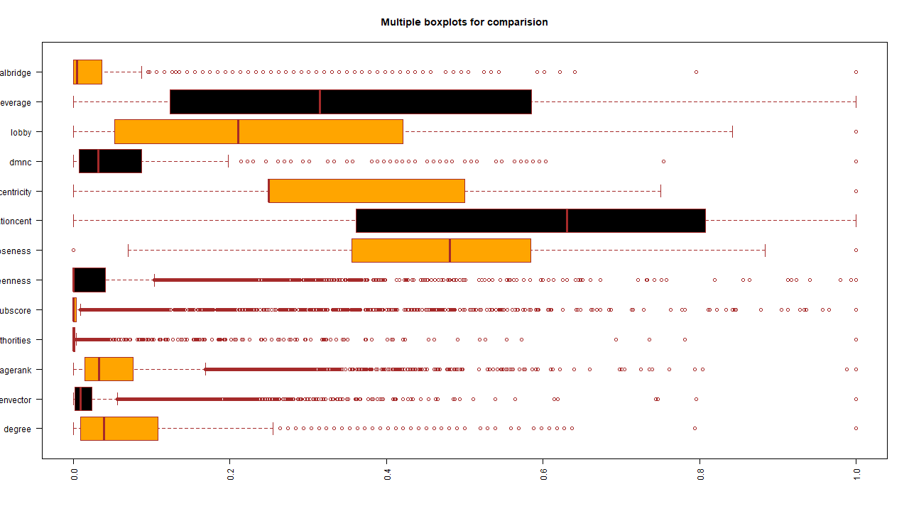
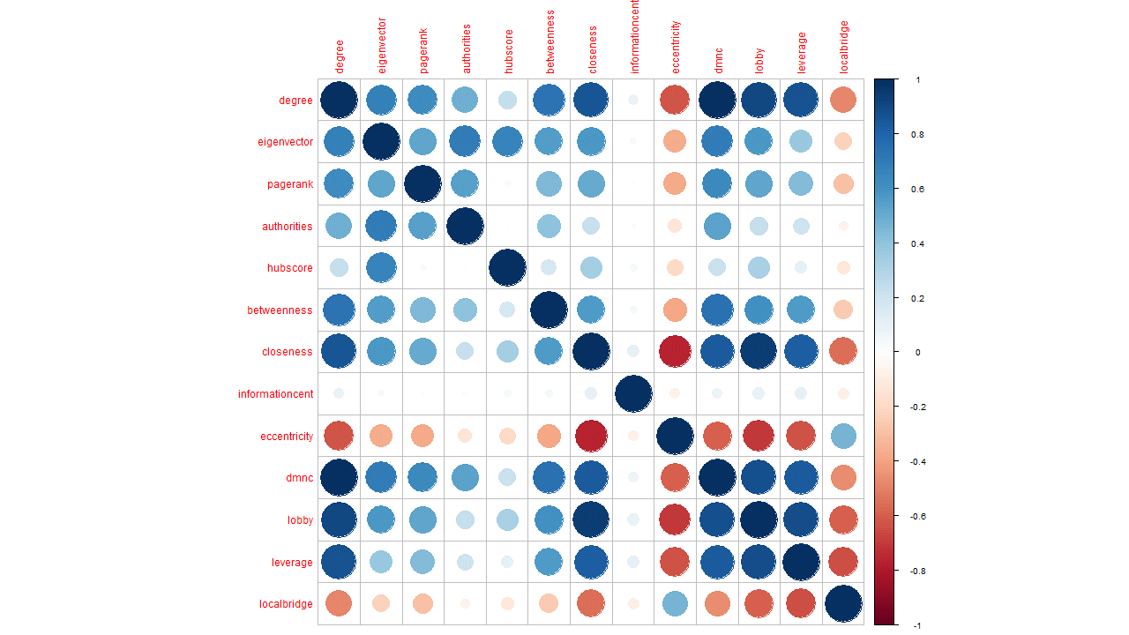
DATA
ANALYSIS
Boxplot
Correlation plot

Slide 13
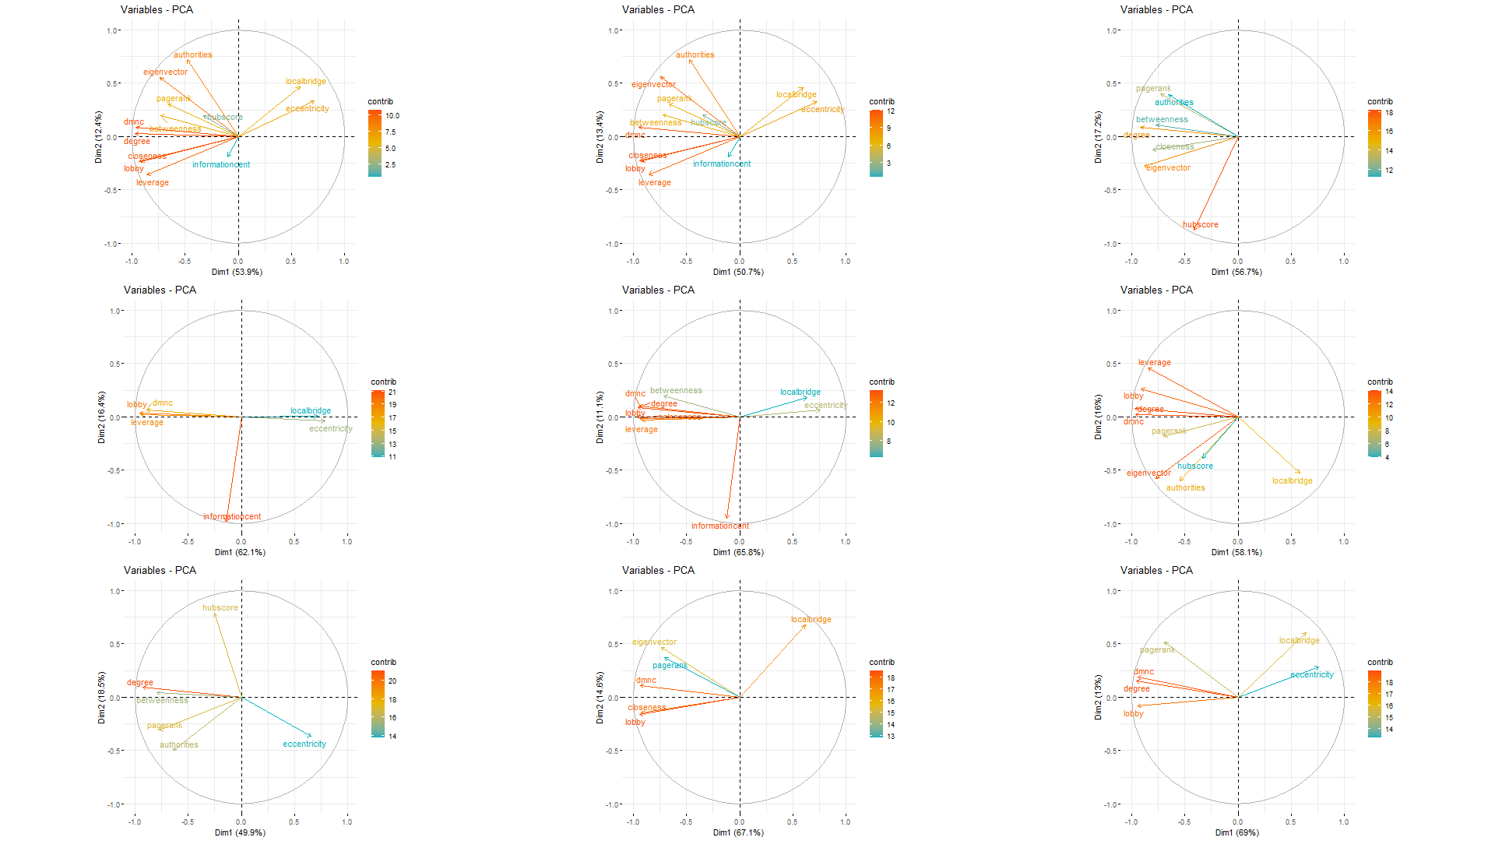
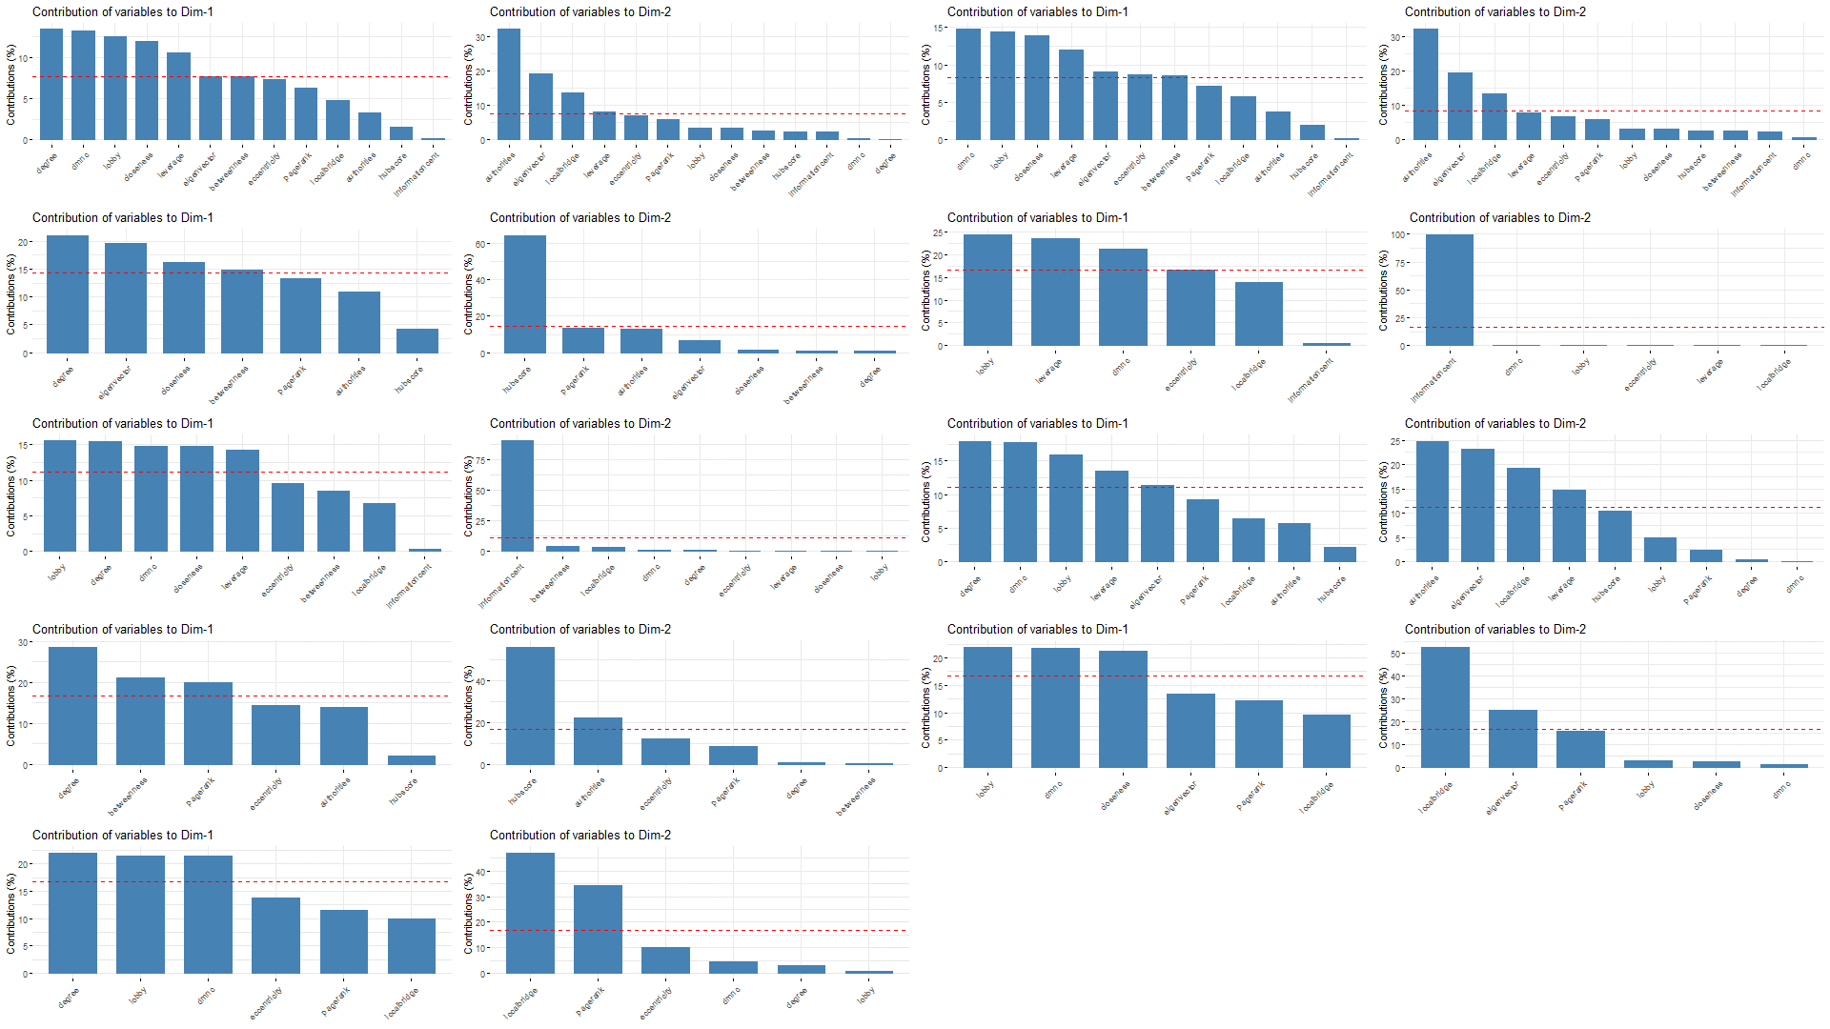
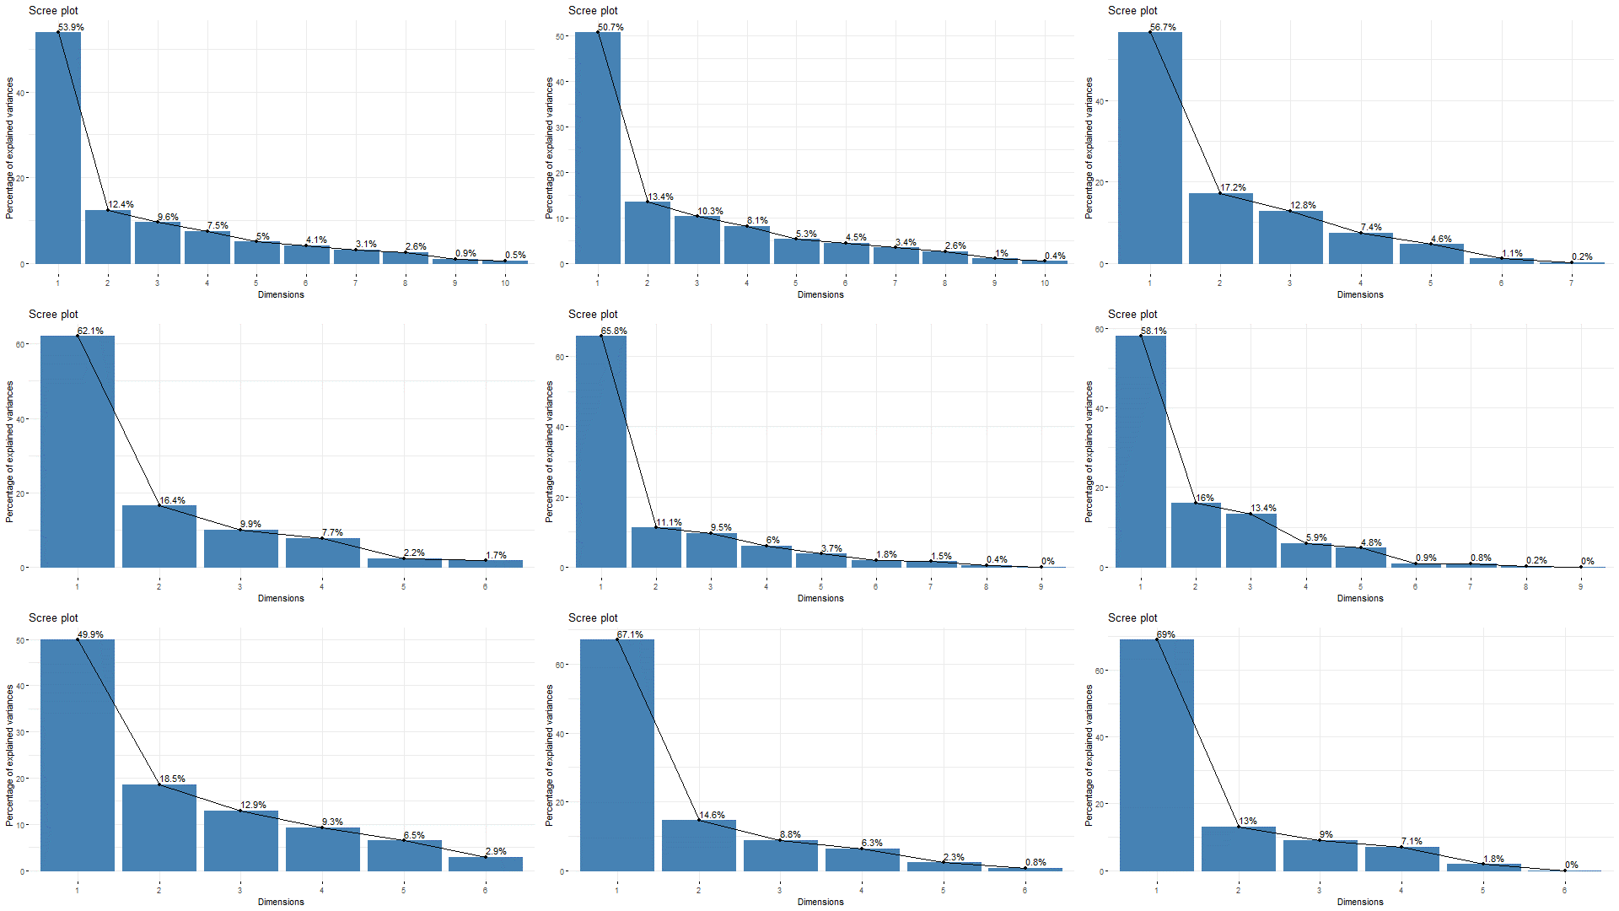
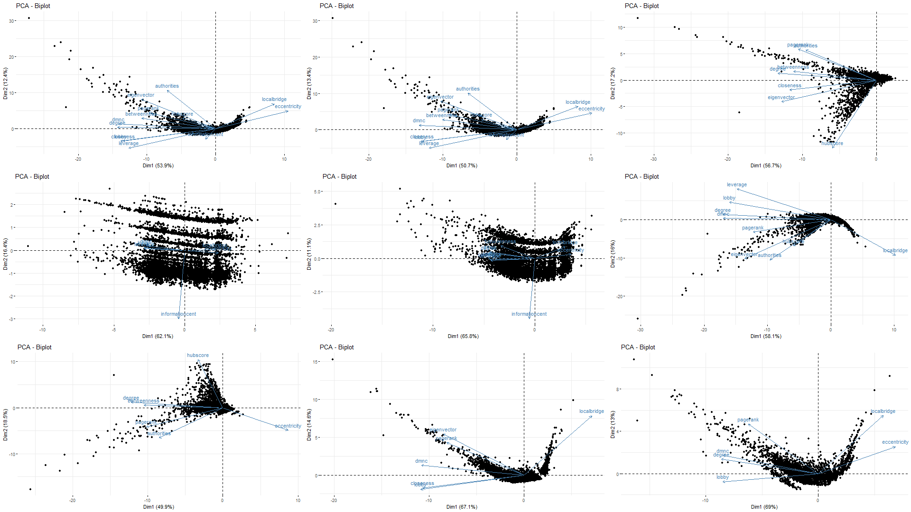
PCA
PLOTS
Cos2 Contribution
Dimension Contribution
Scree plot
Biplot

Slide 14
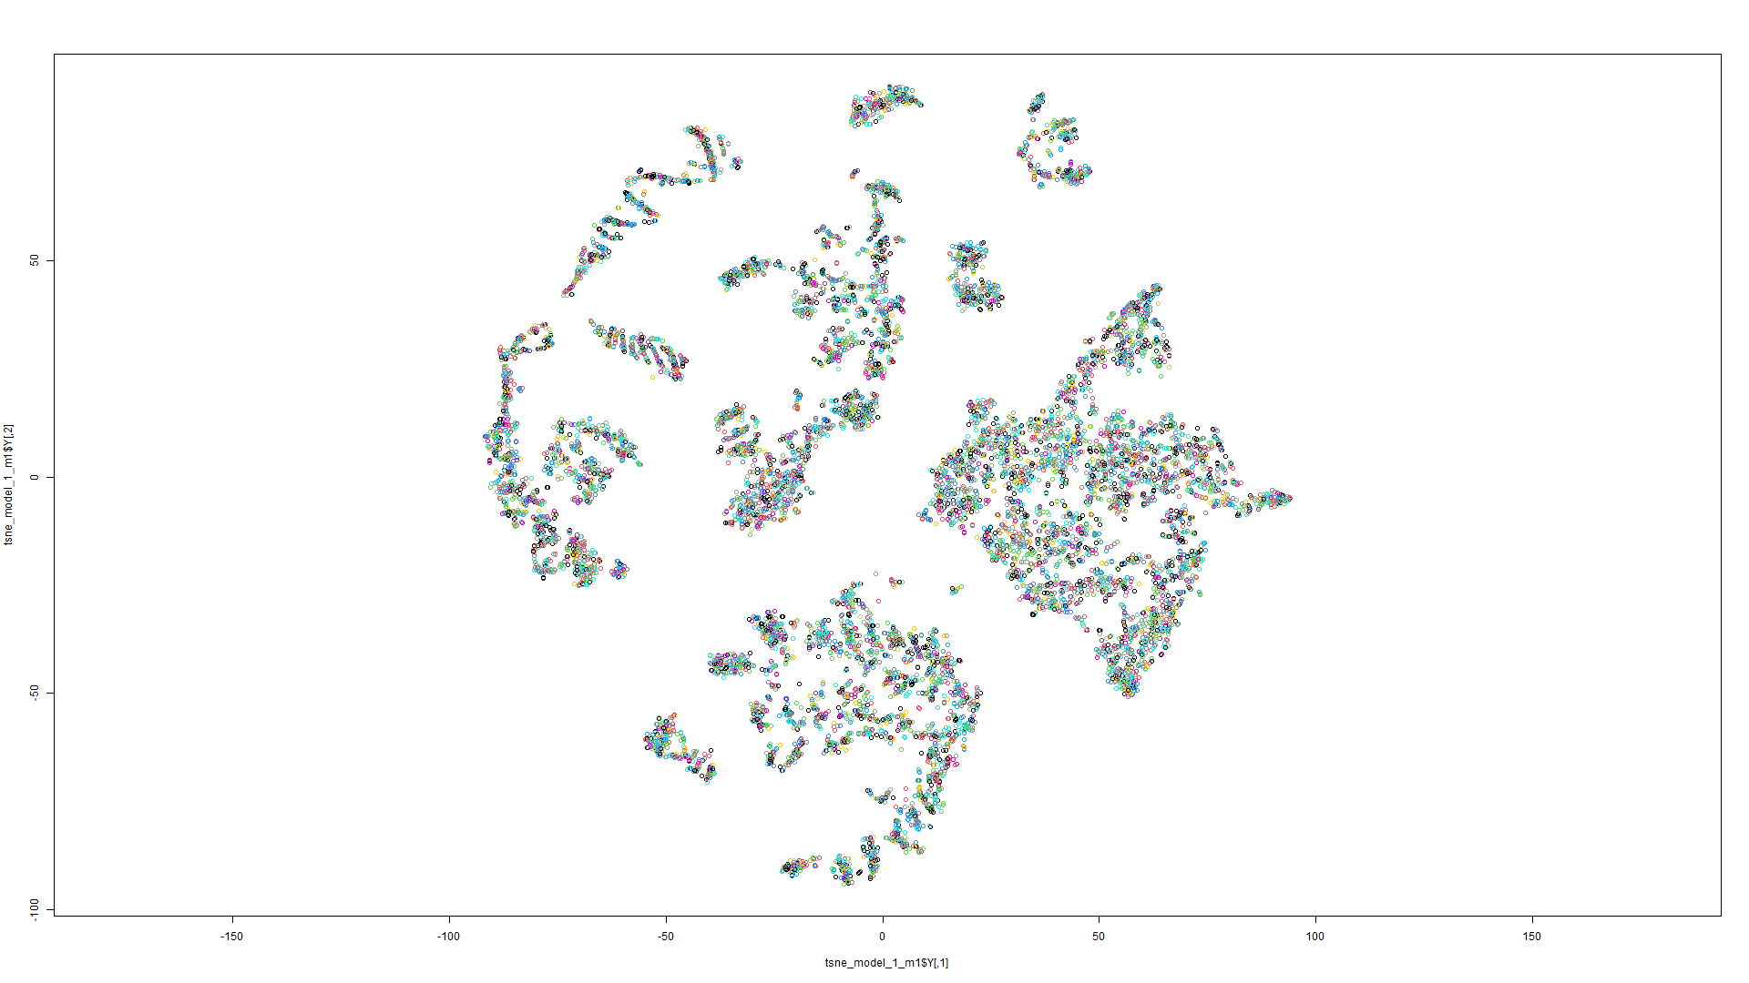
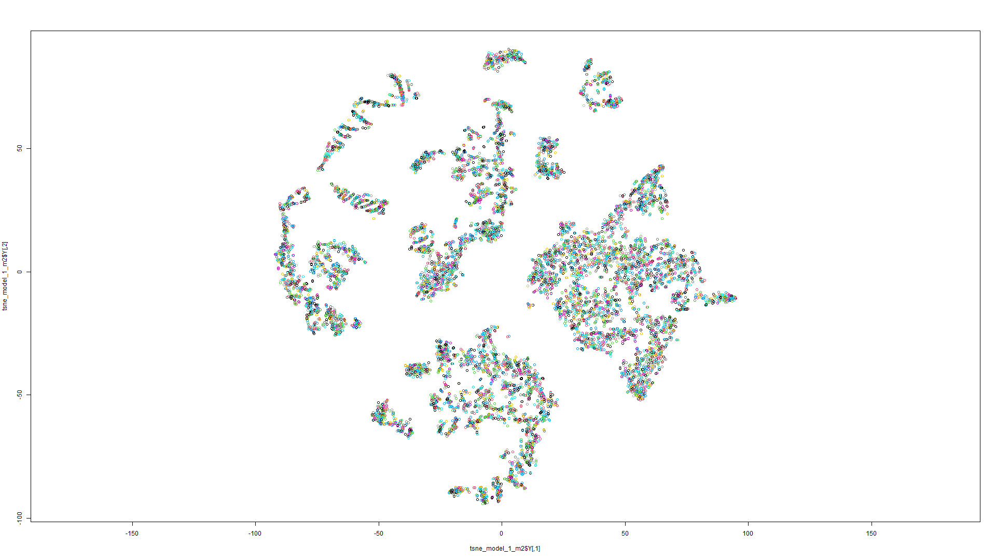
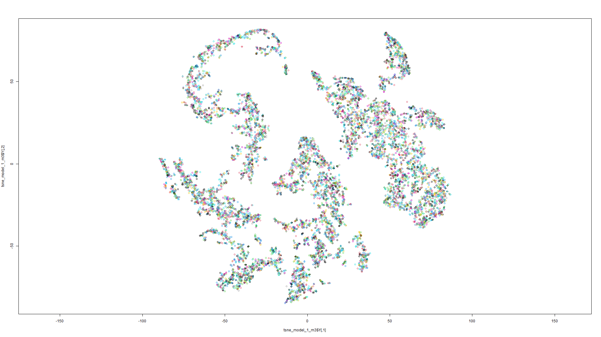
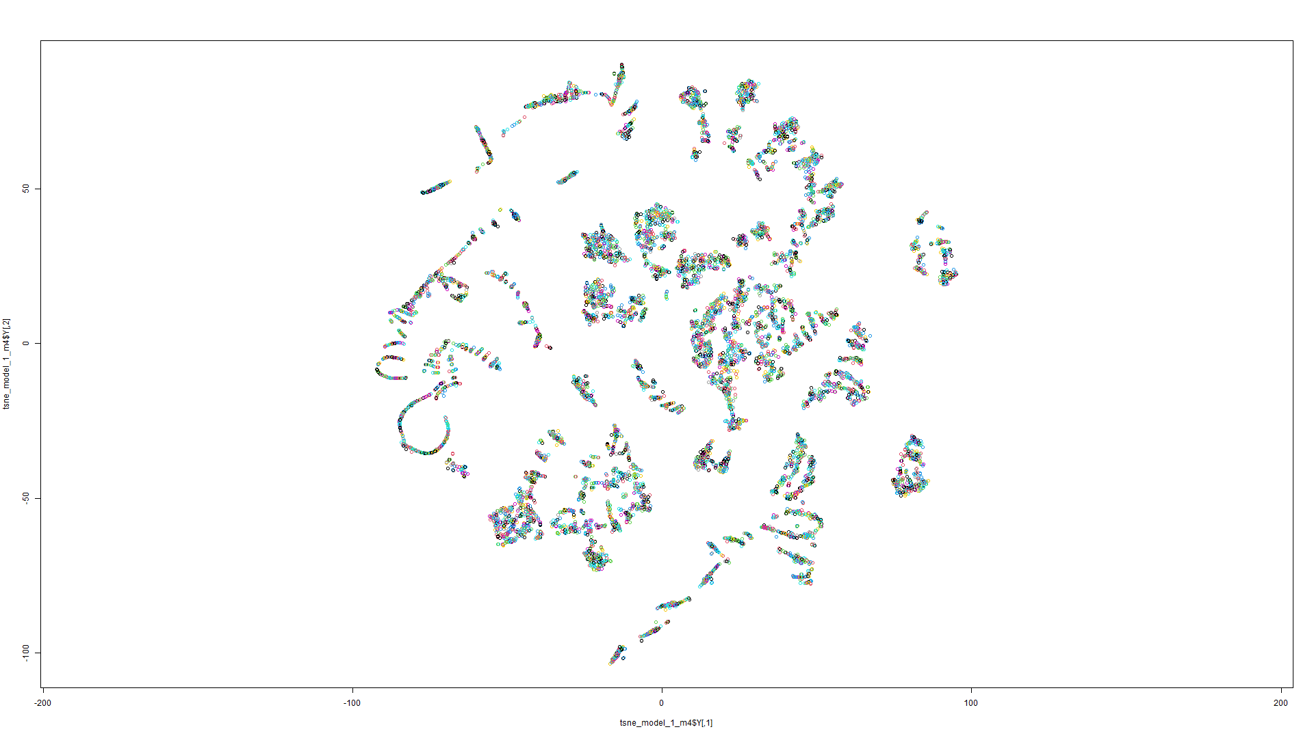
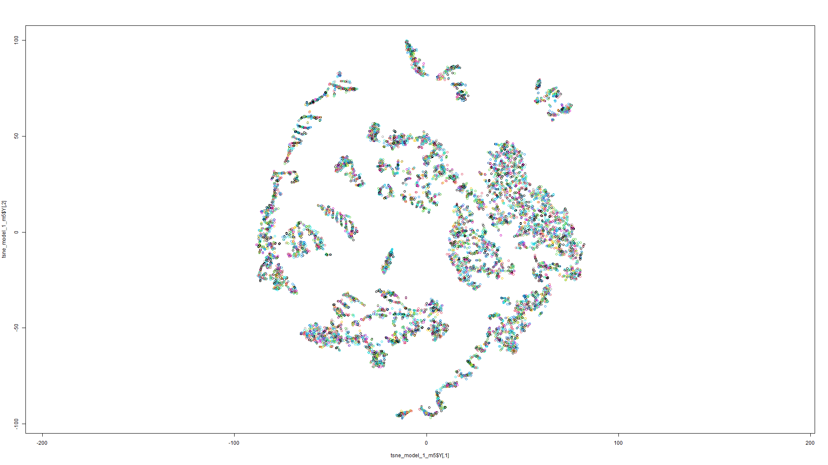
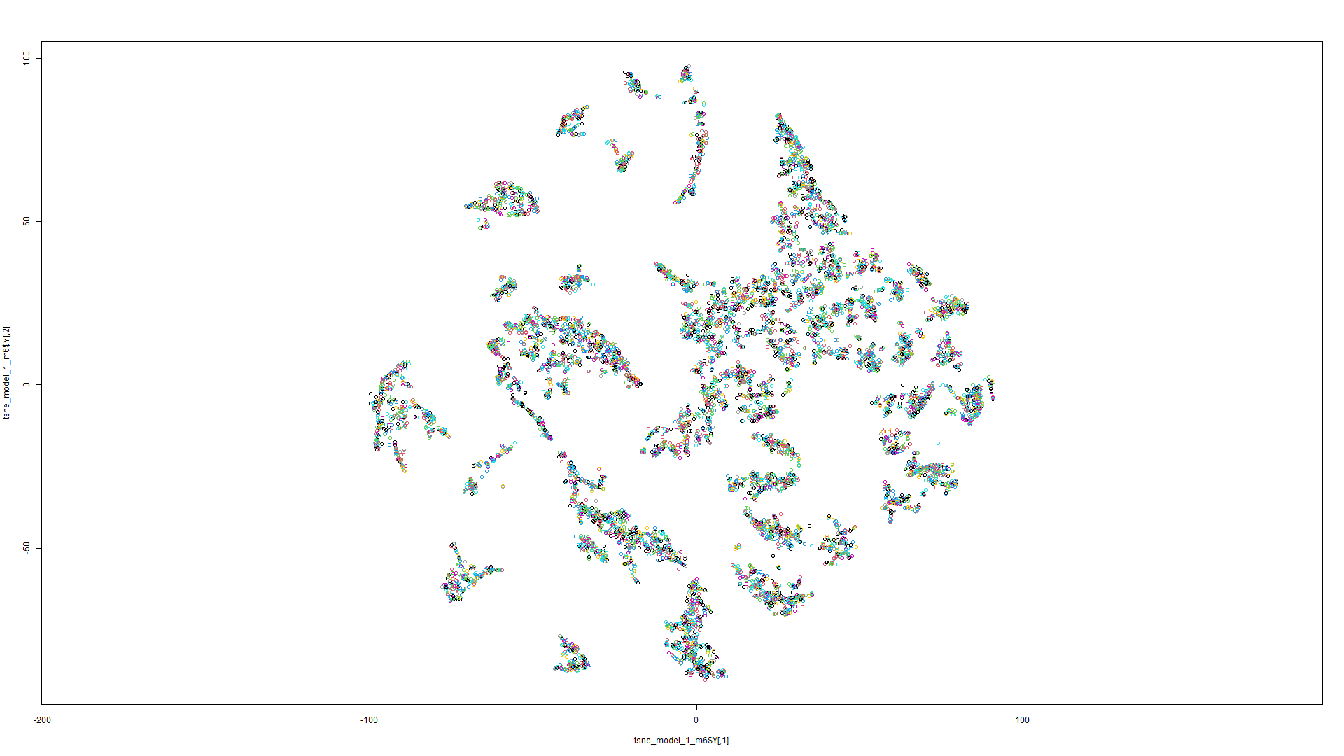
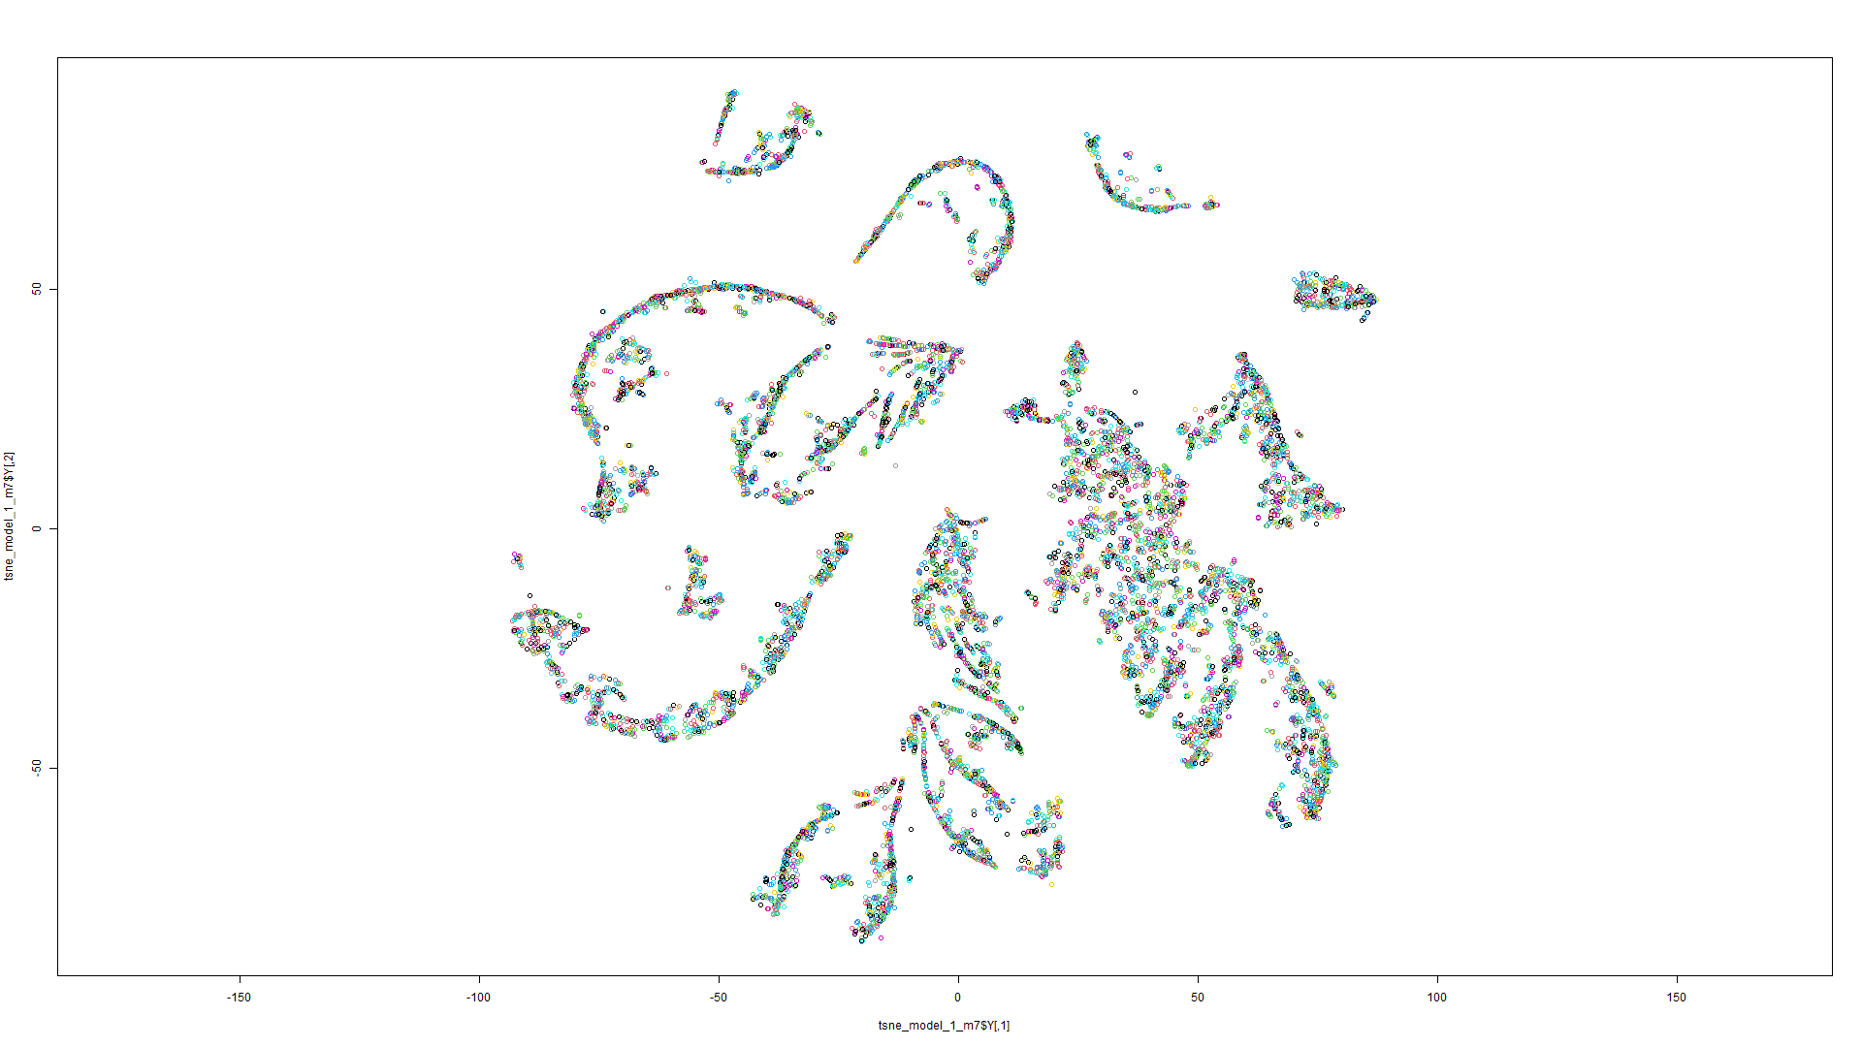
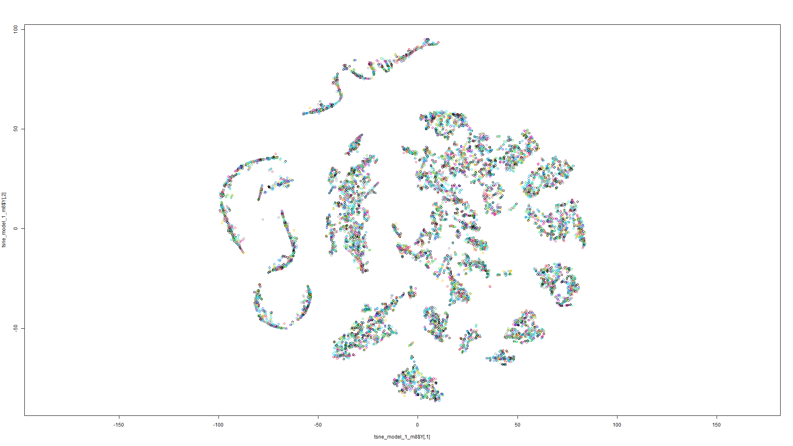
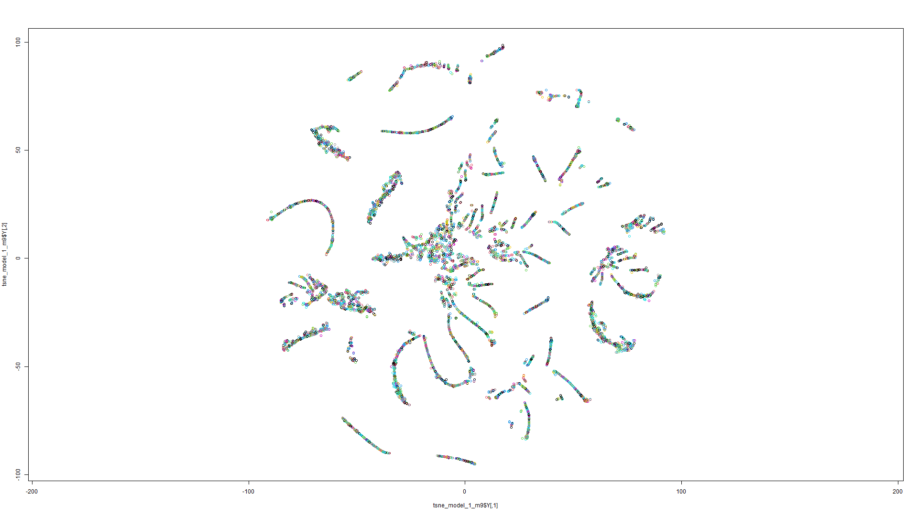
t-
S
N
E
P
L
O
T
S
(1st
M
O
D
E
L)
Model 1
Model 2
Model 3
Model 4
Model 5
Model 6
Model 7
Model 8
Model 9

Slide 15
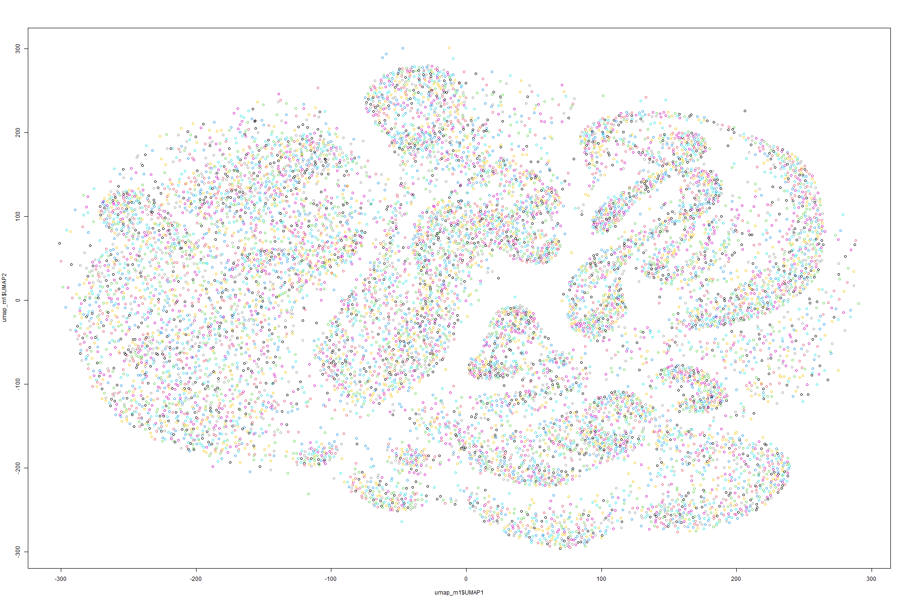
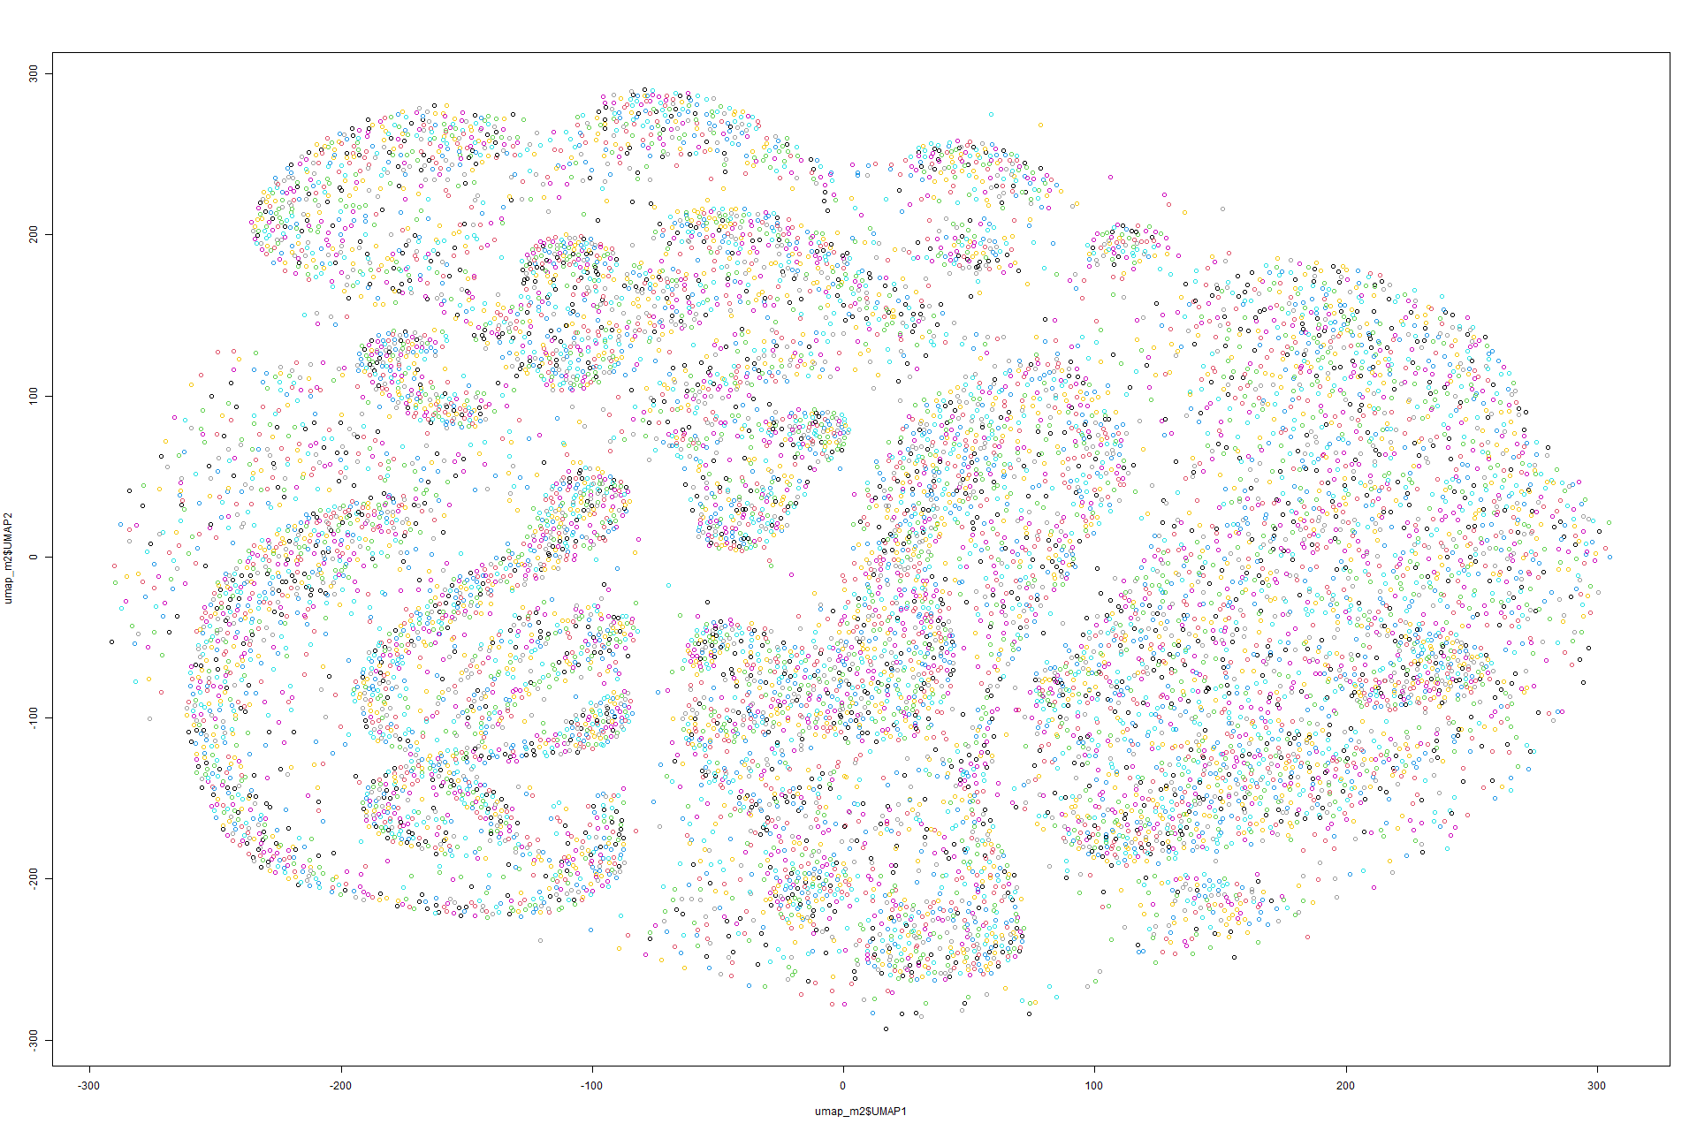
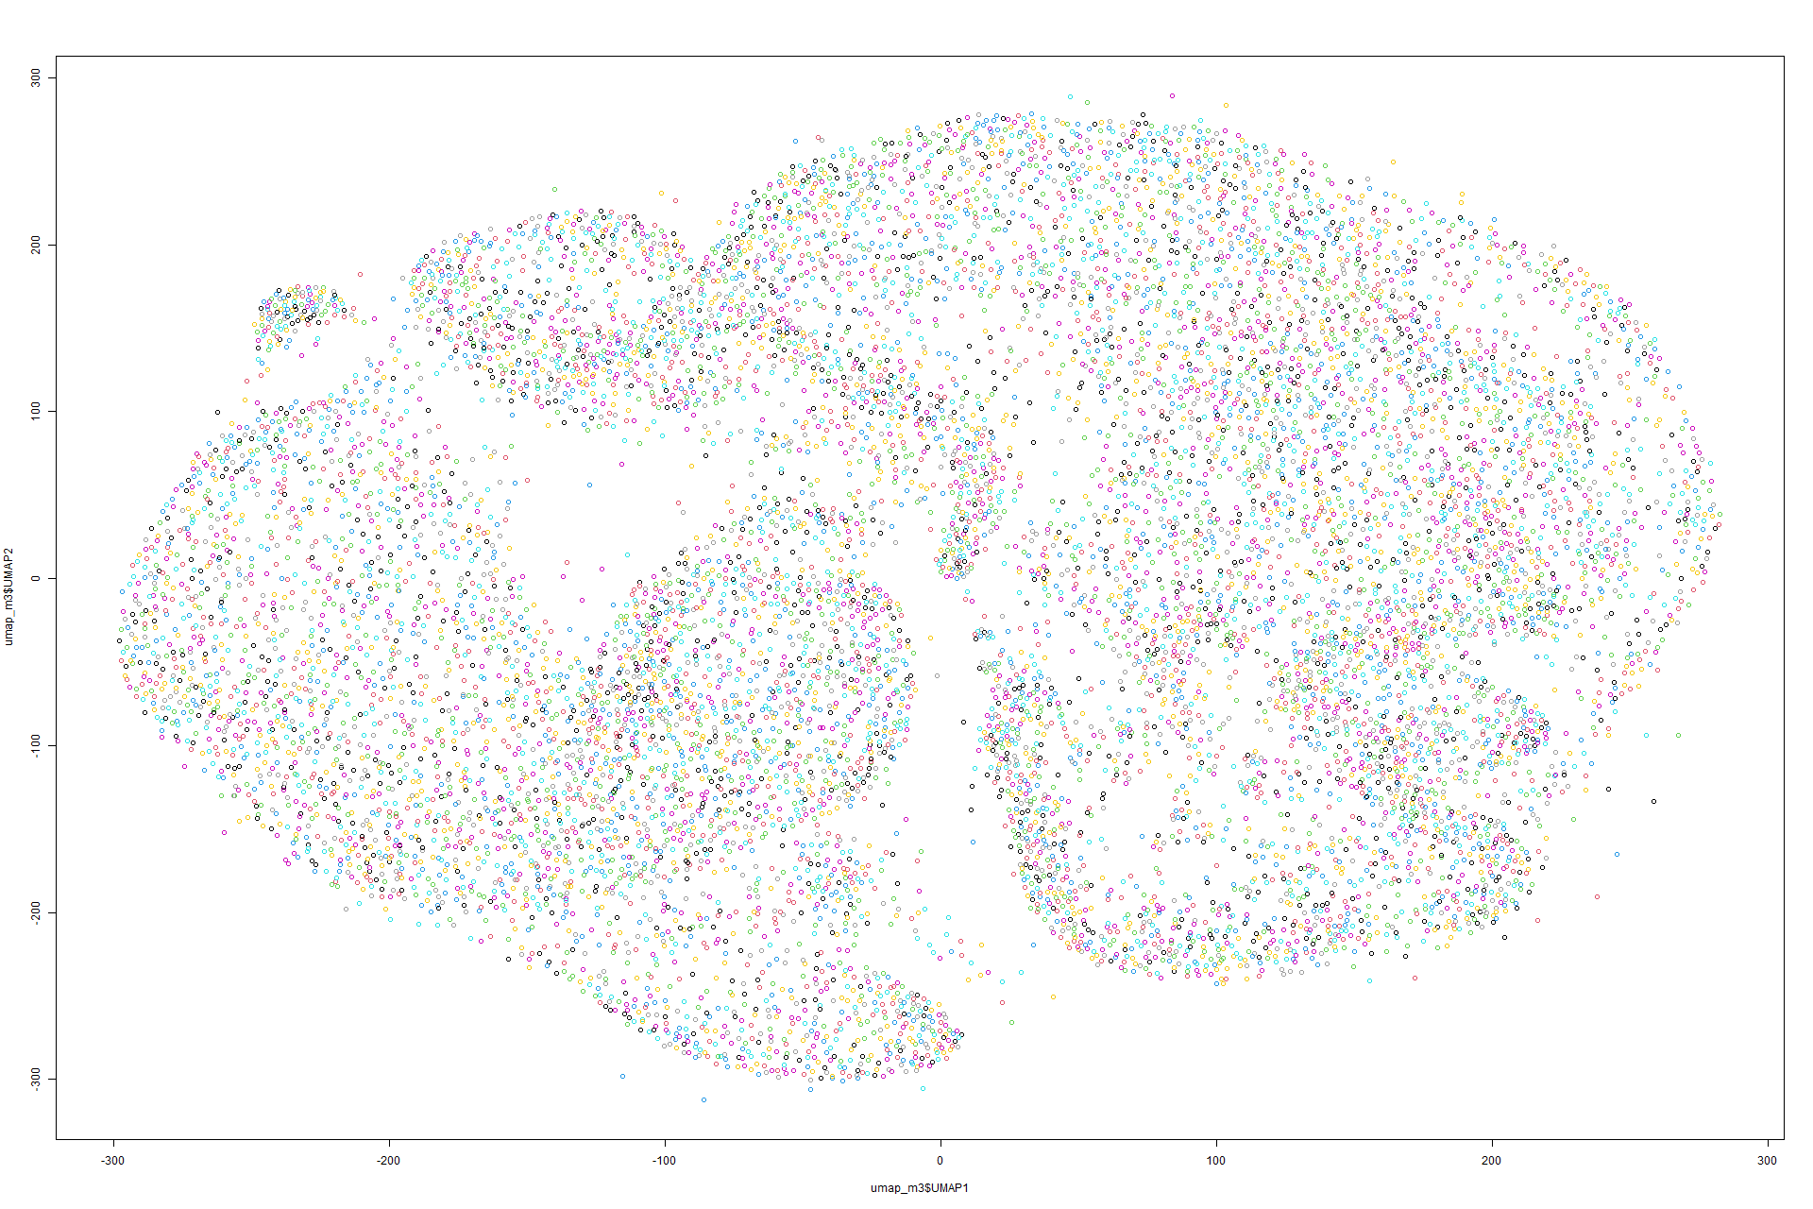
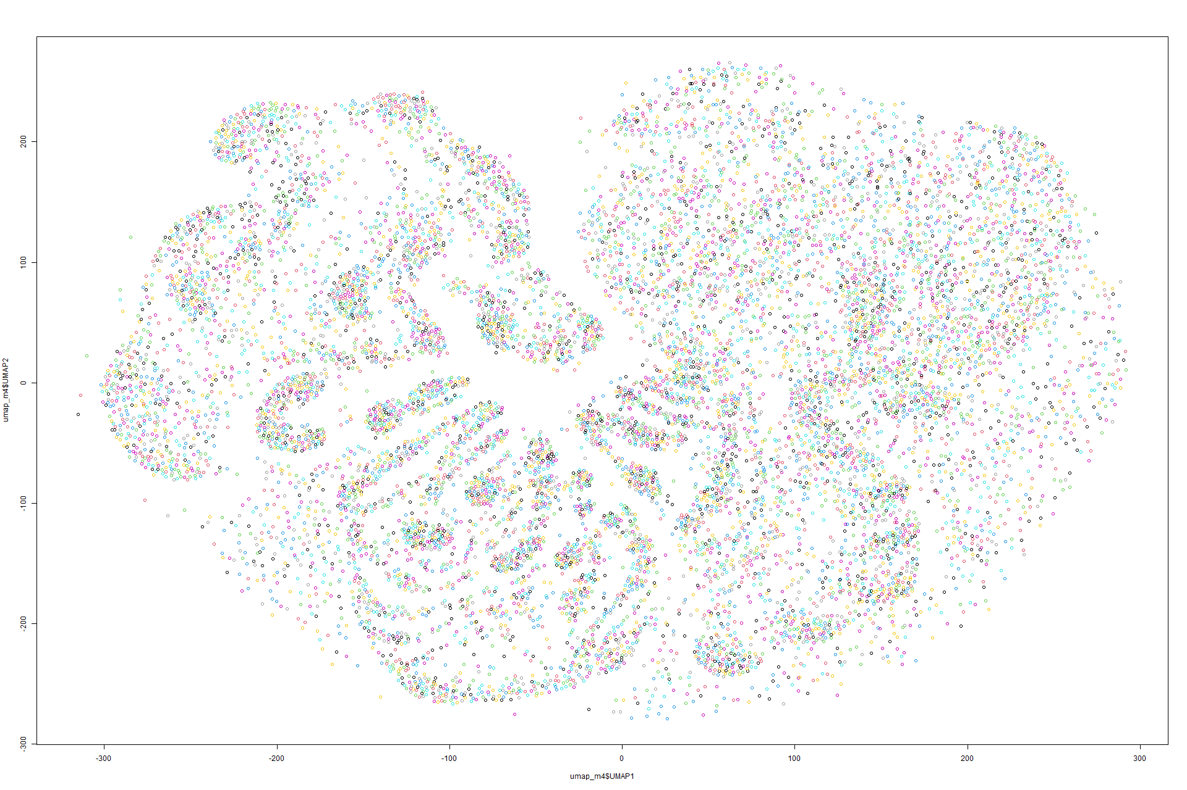
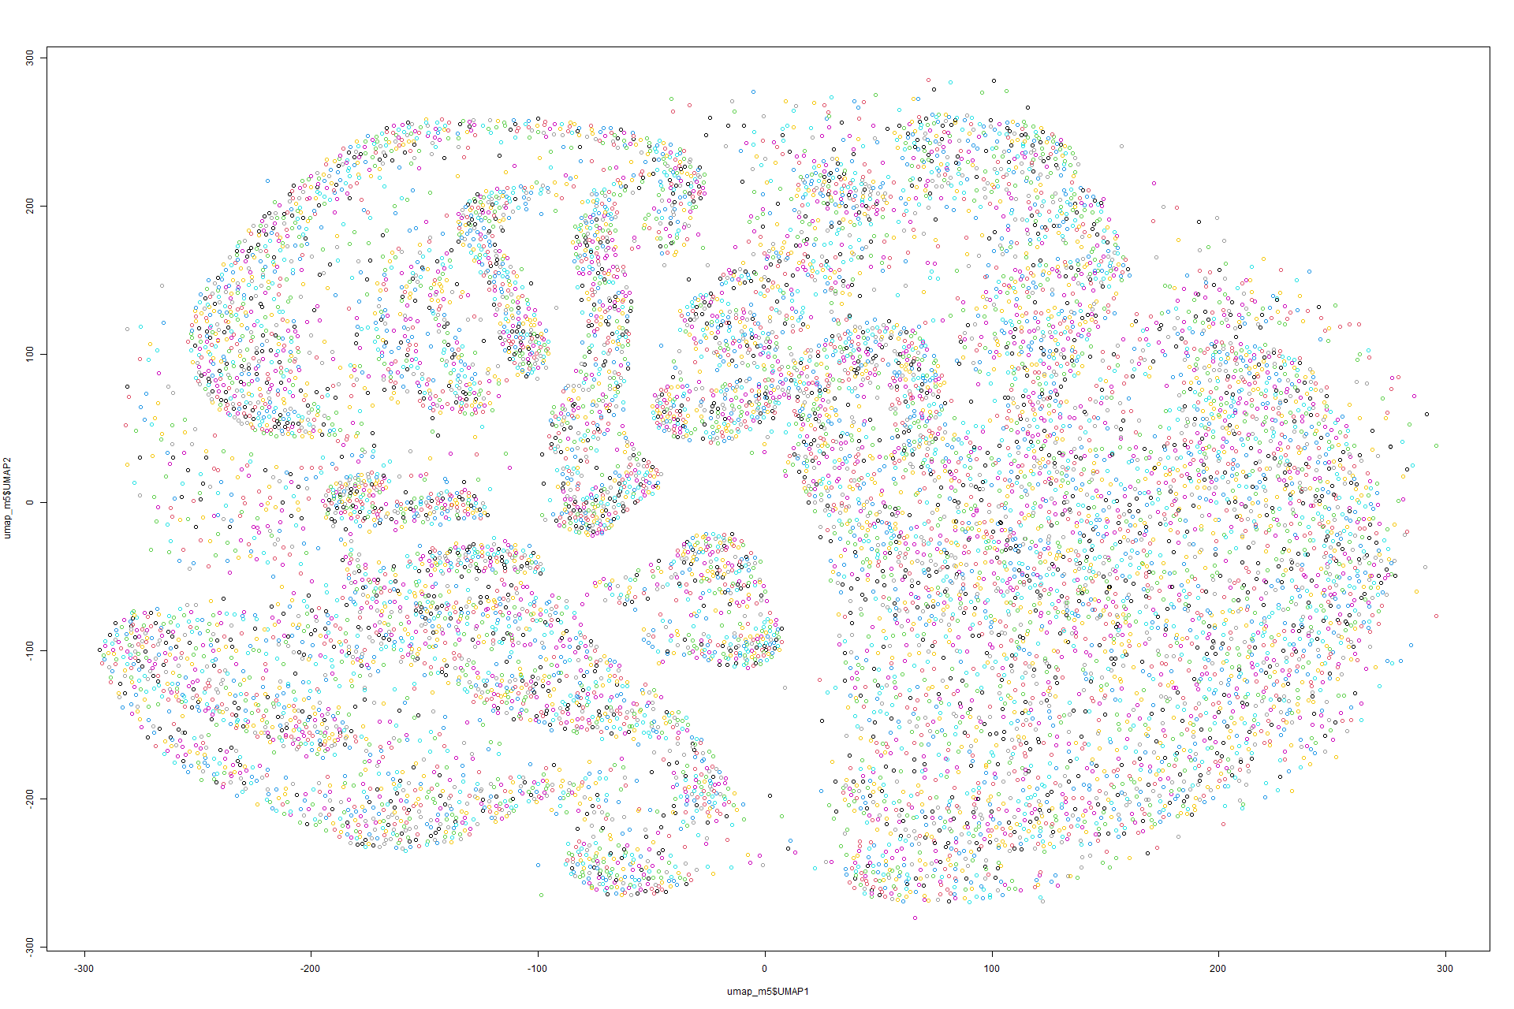
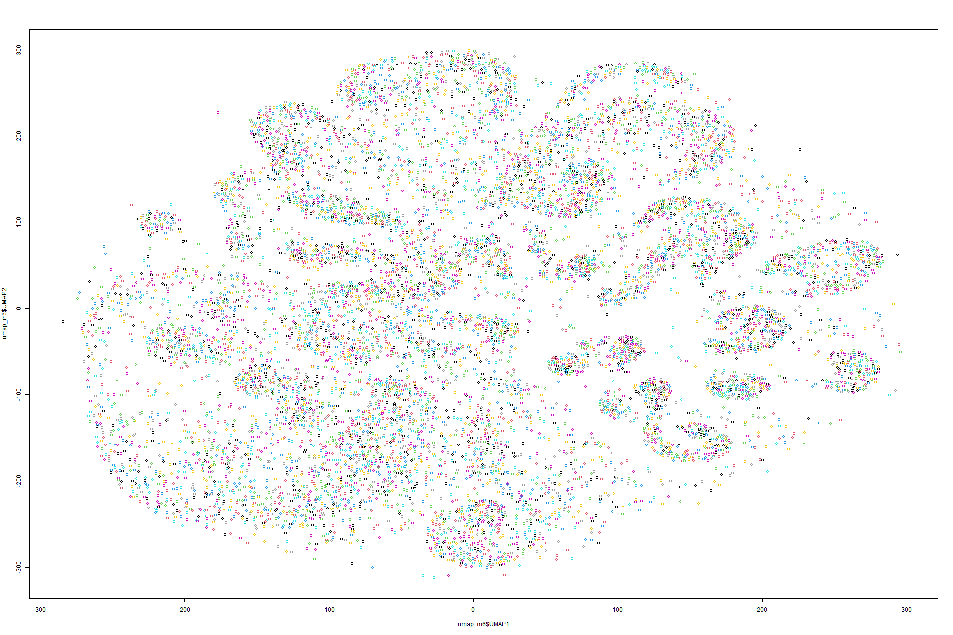
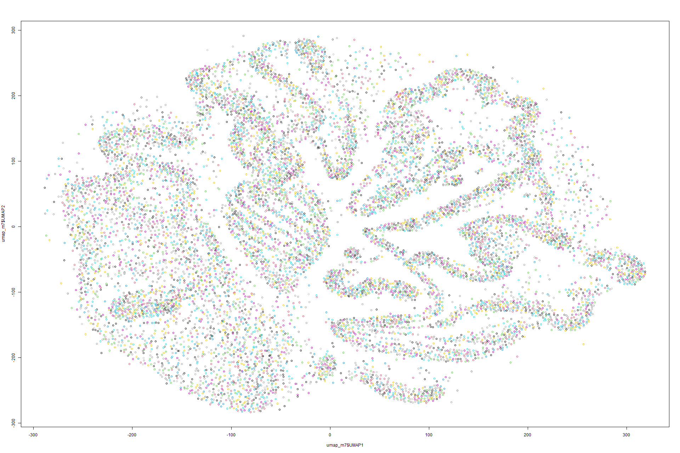
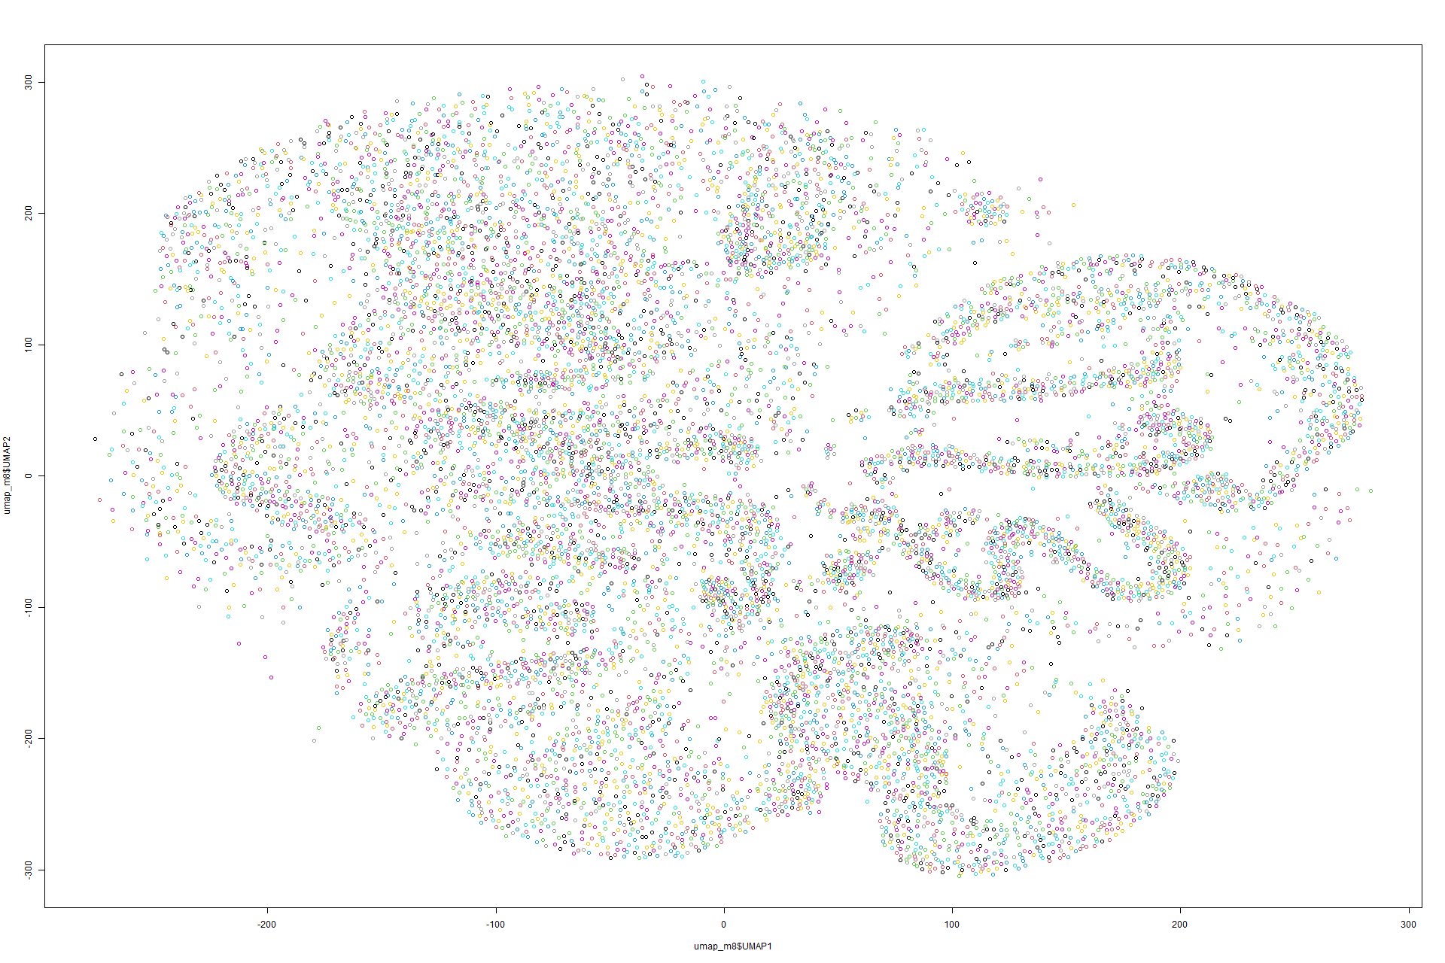
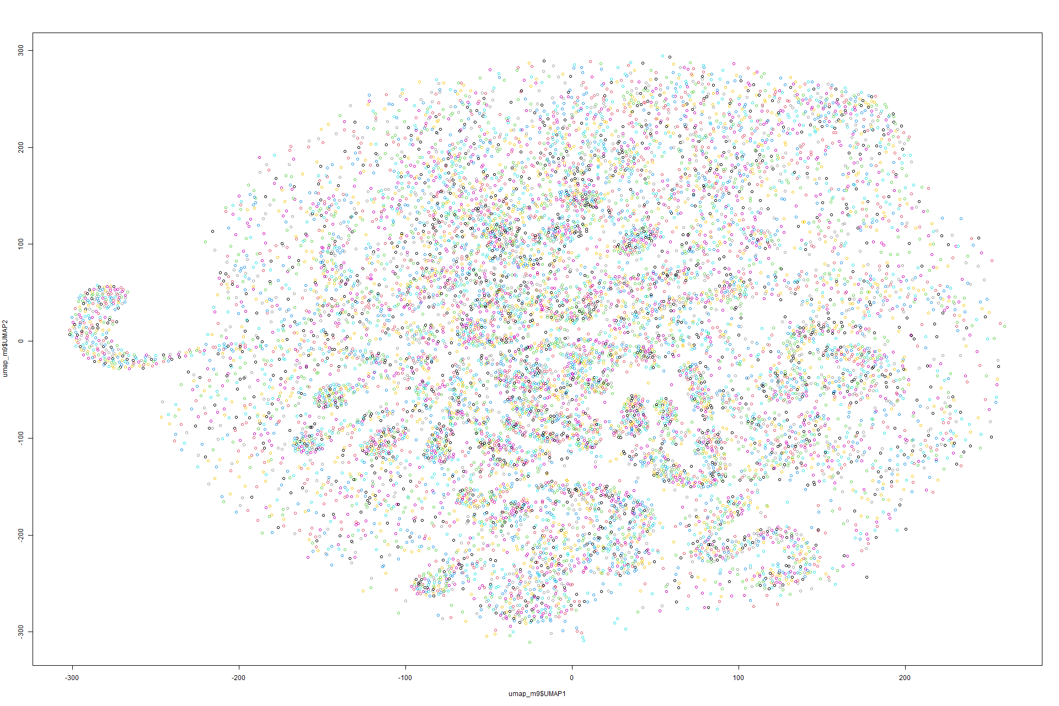
UMAP
PLOTS
Model 1
Model 2
Model 3
Model 4
Model 5
Model 6
Model 7
Model 8
Model 9

Slide 16
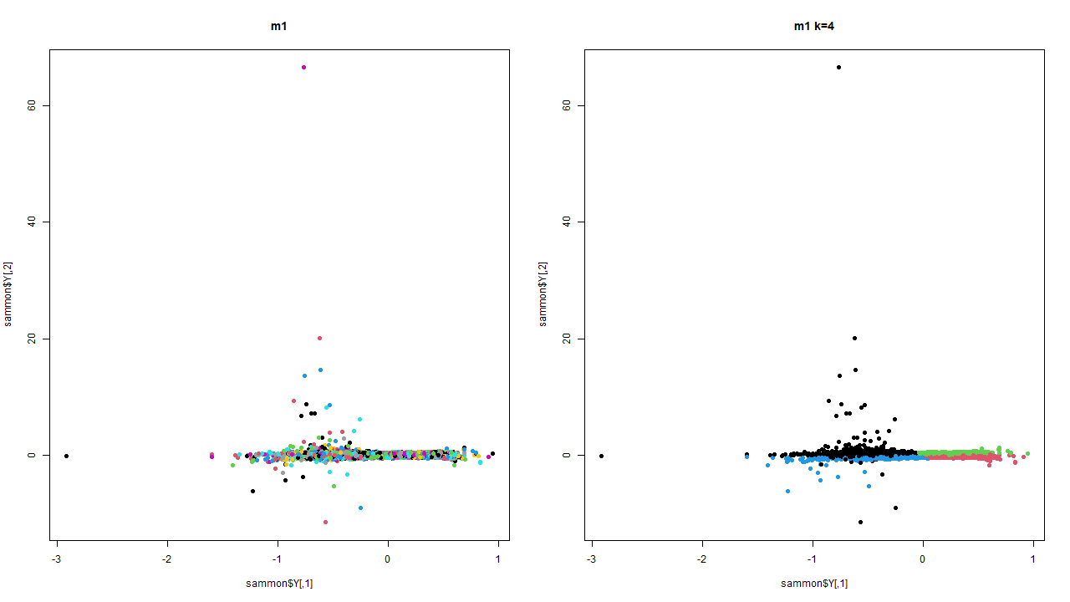
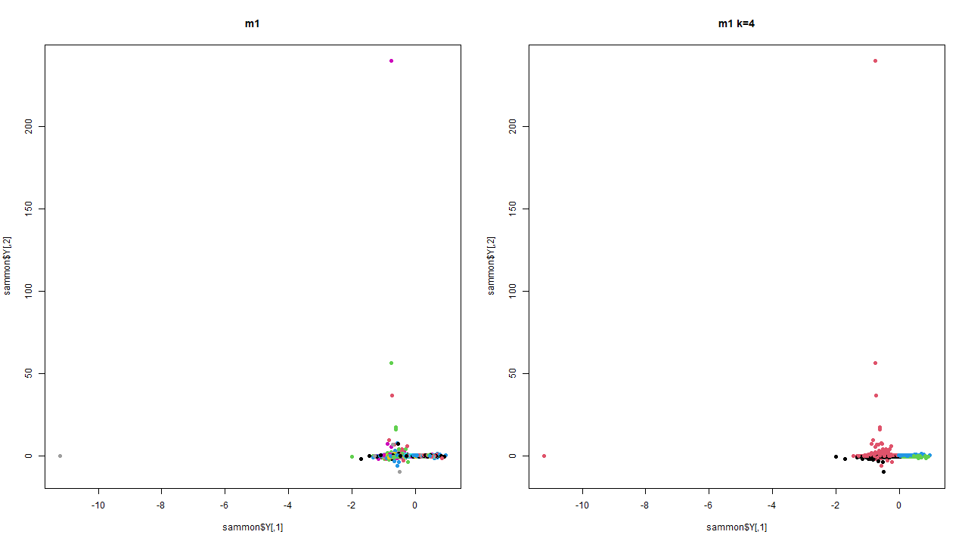
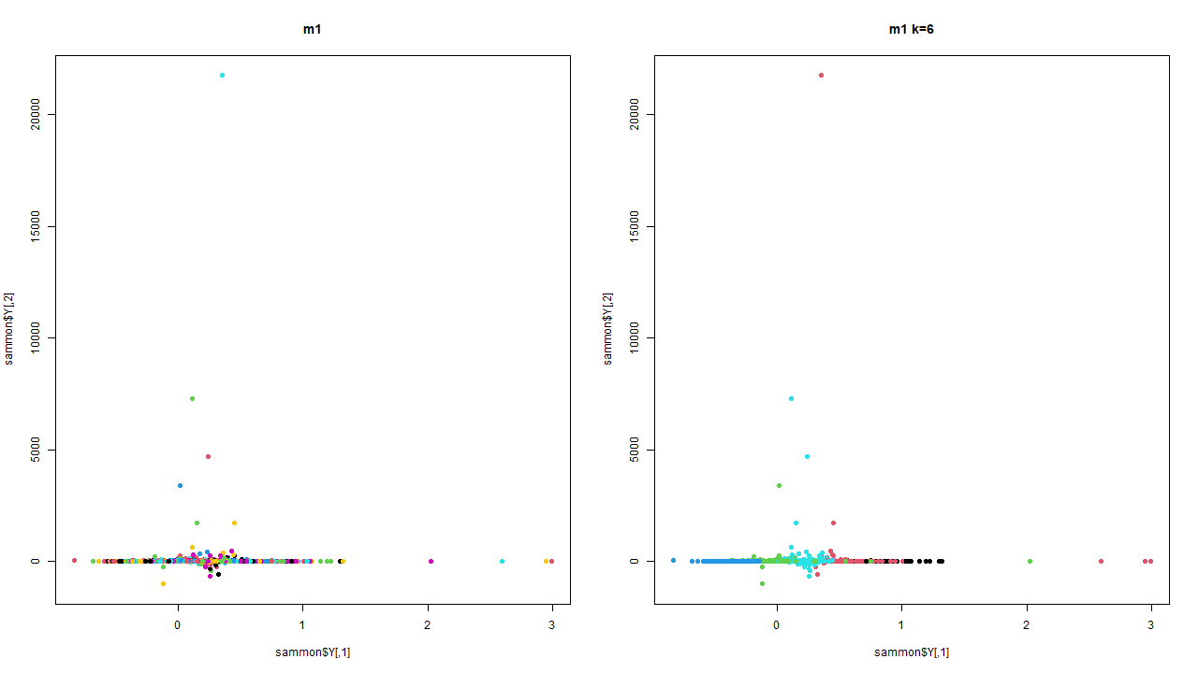
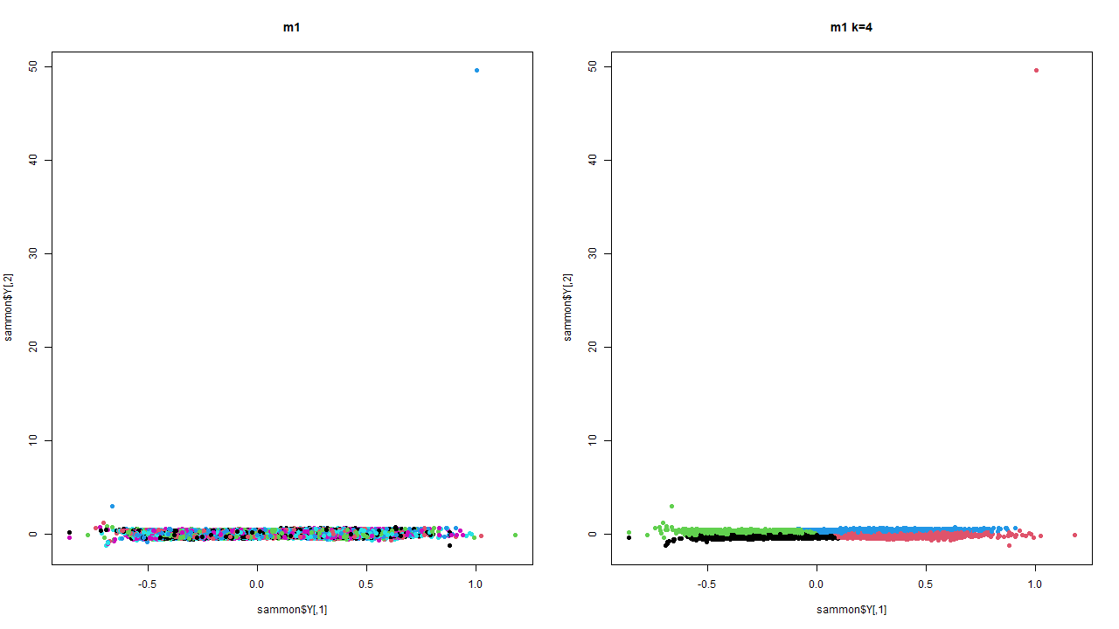
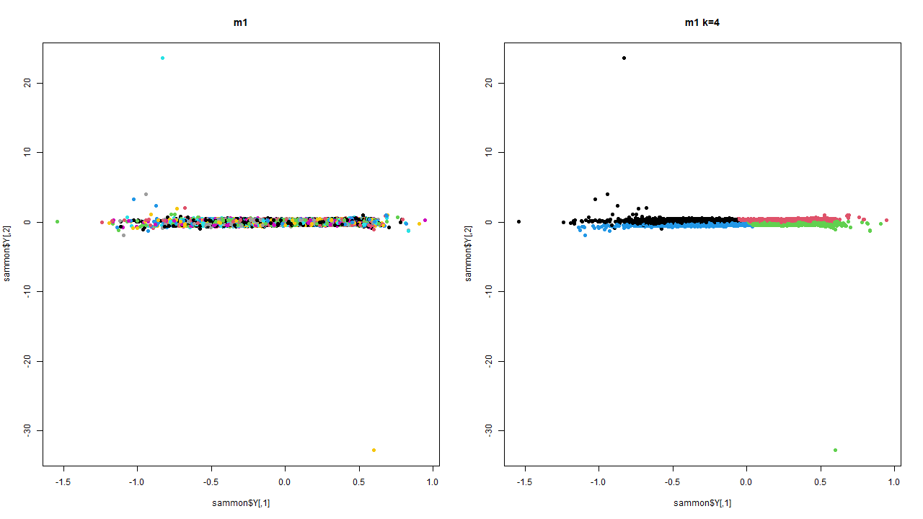
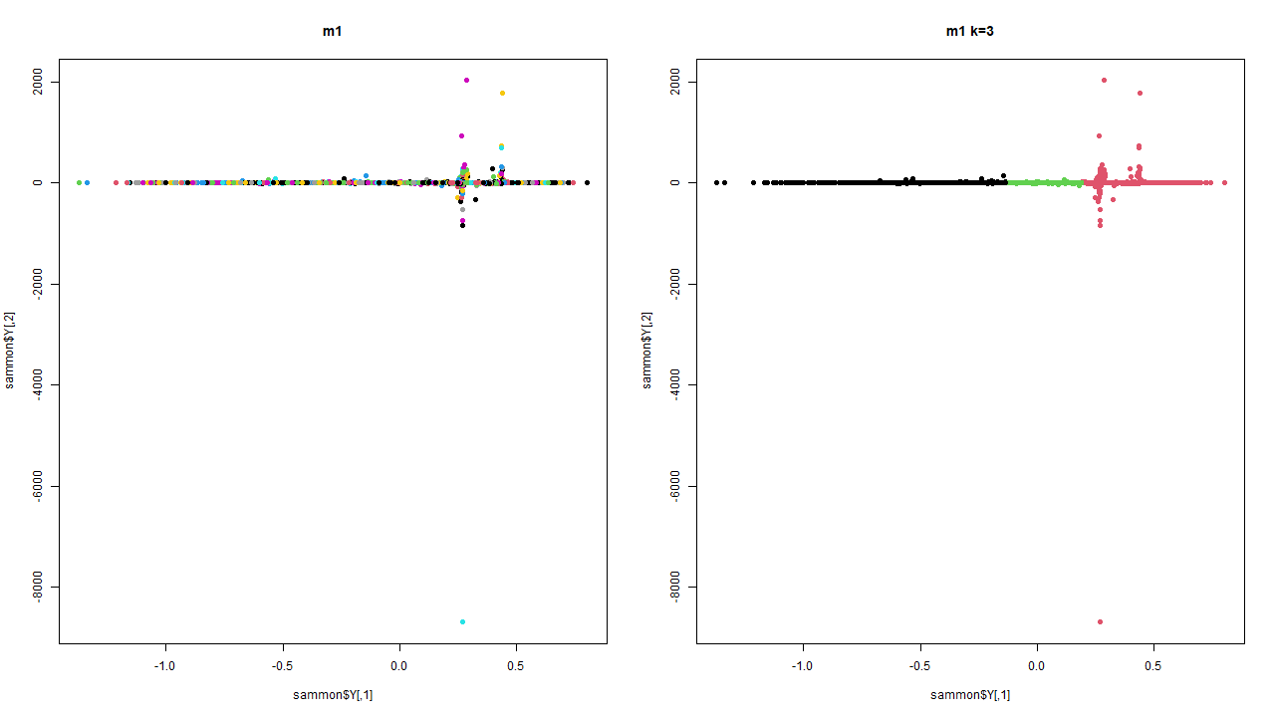
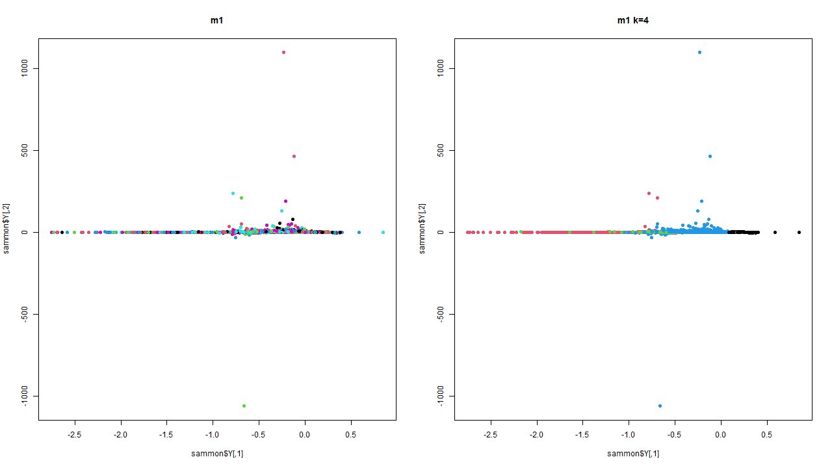
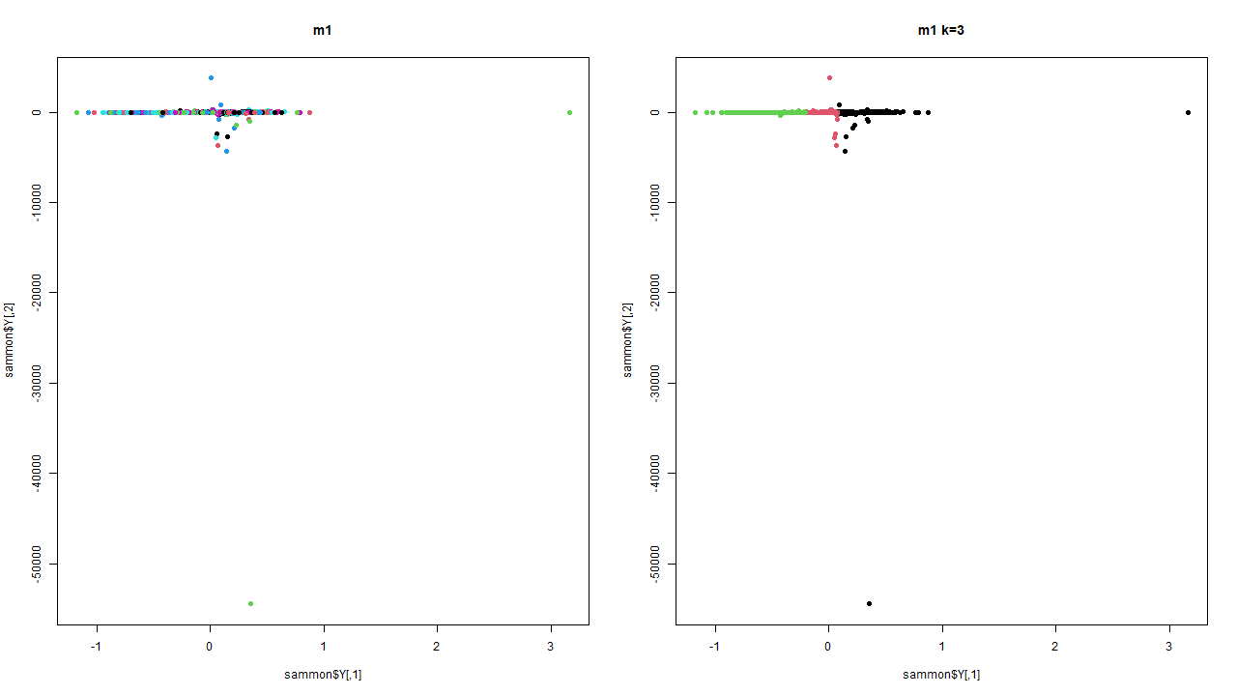
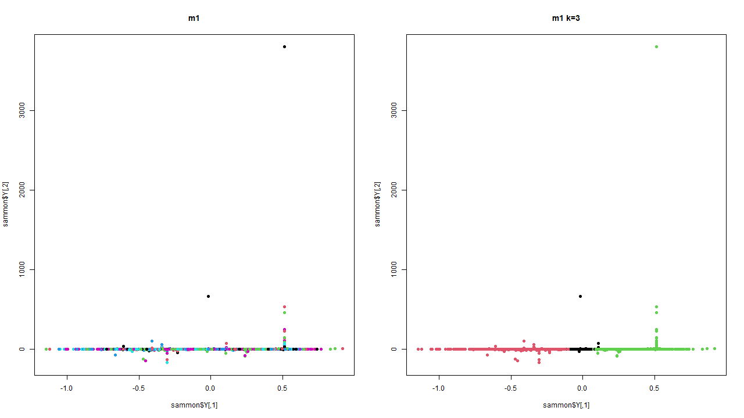
SAMMON
MAP
PLOTS
Model 1
Model 2
Model 3
Model 4
Model 5
Model 6
Model 7
Model 8
Model 9

Slide 17
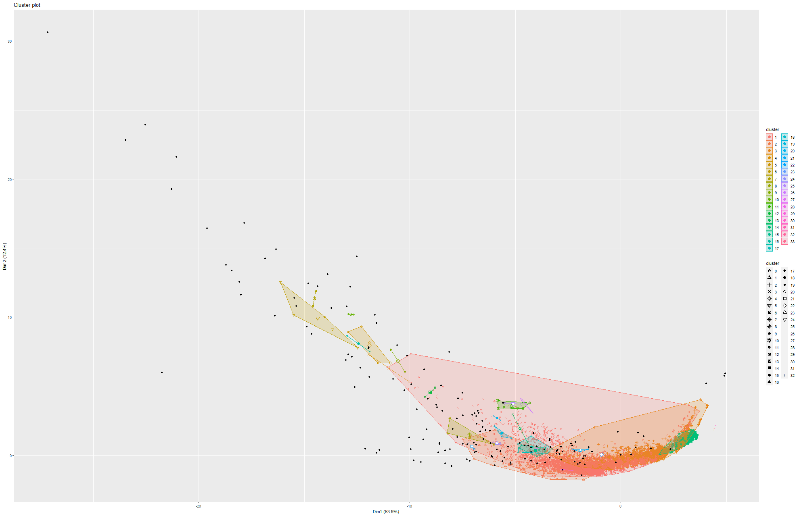
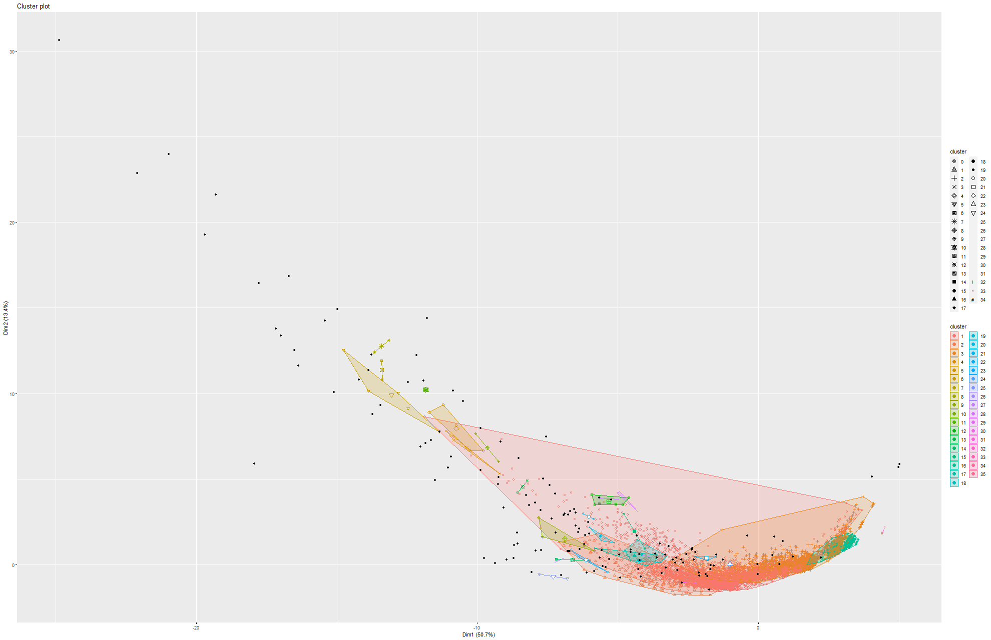
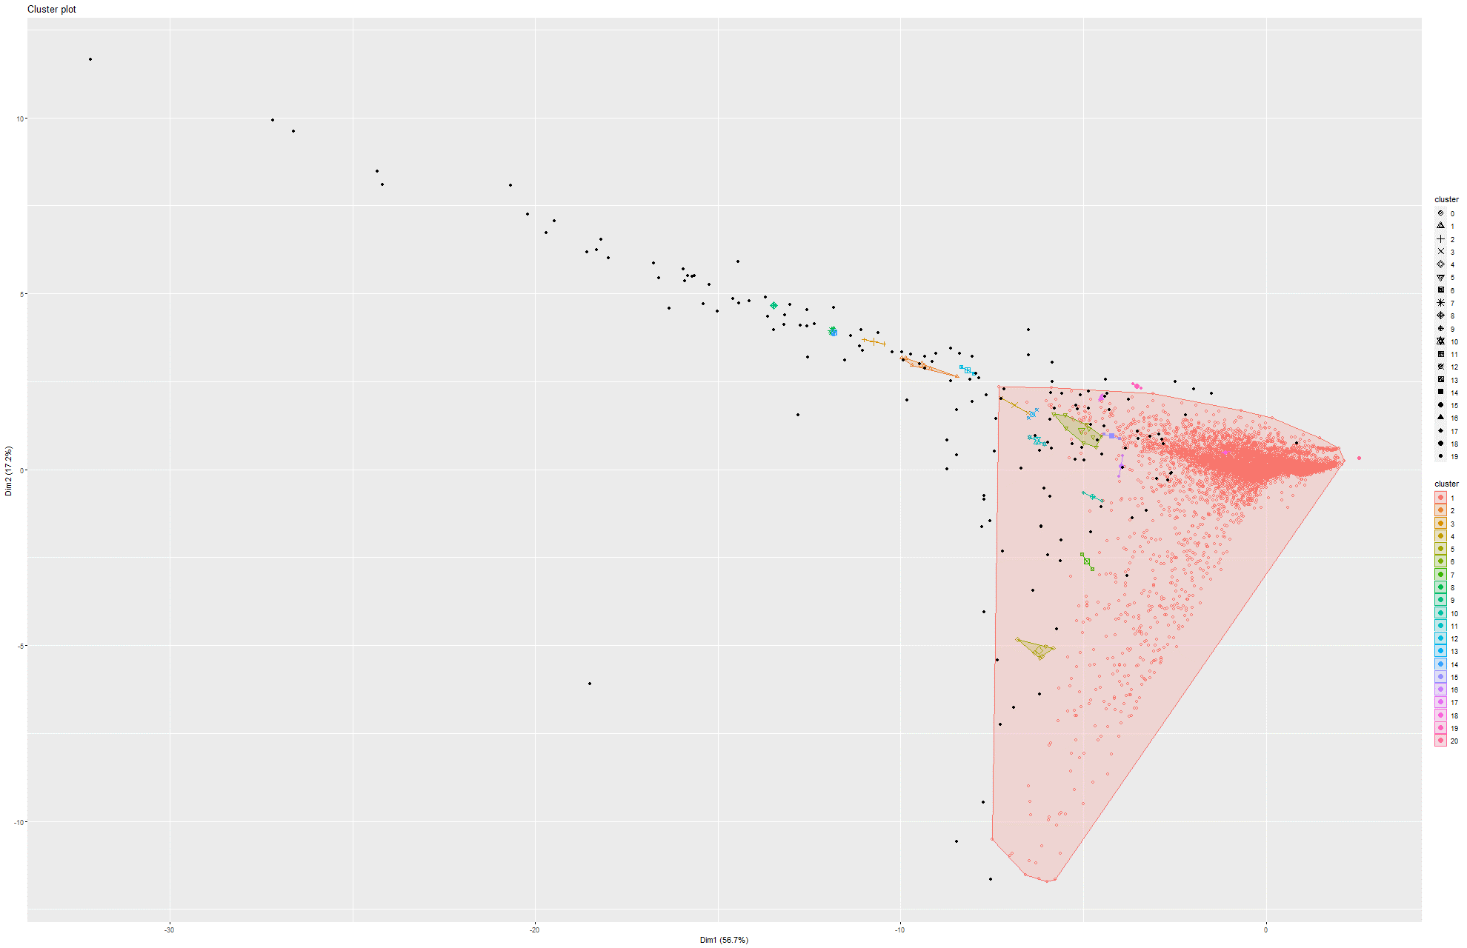
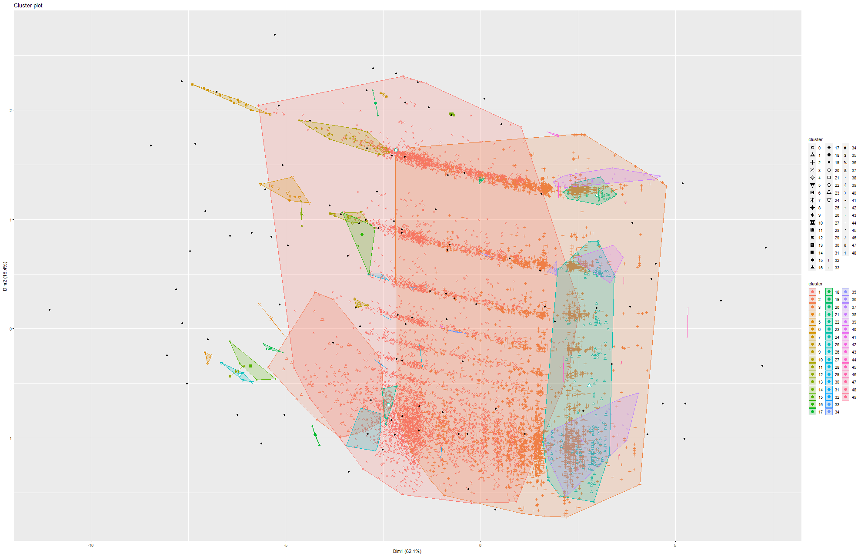
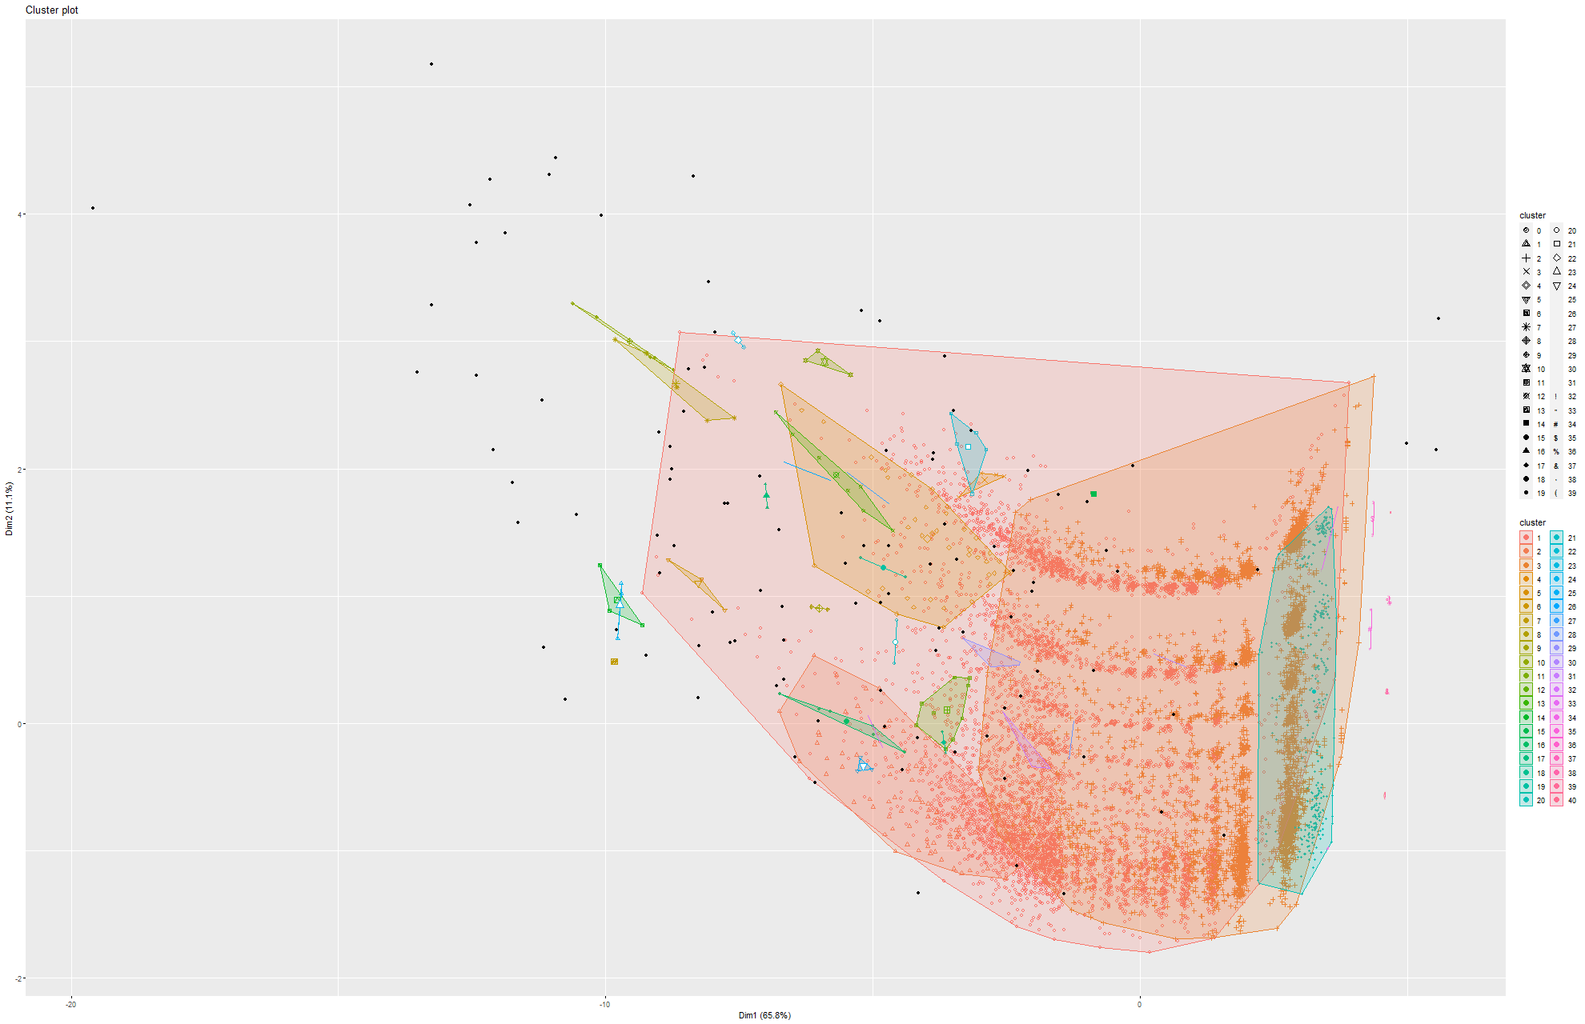
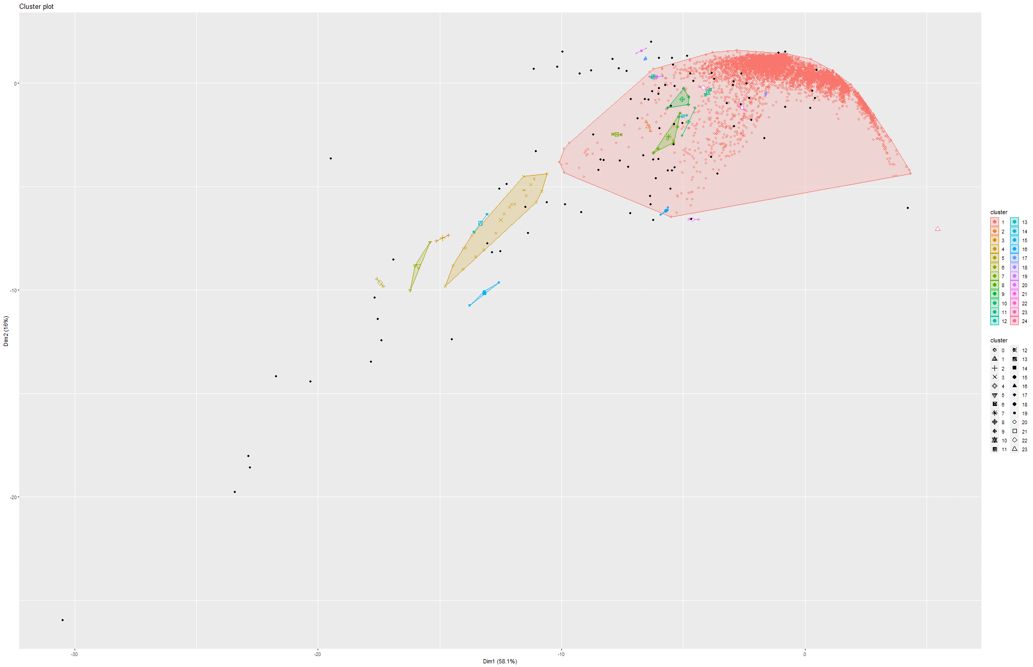
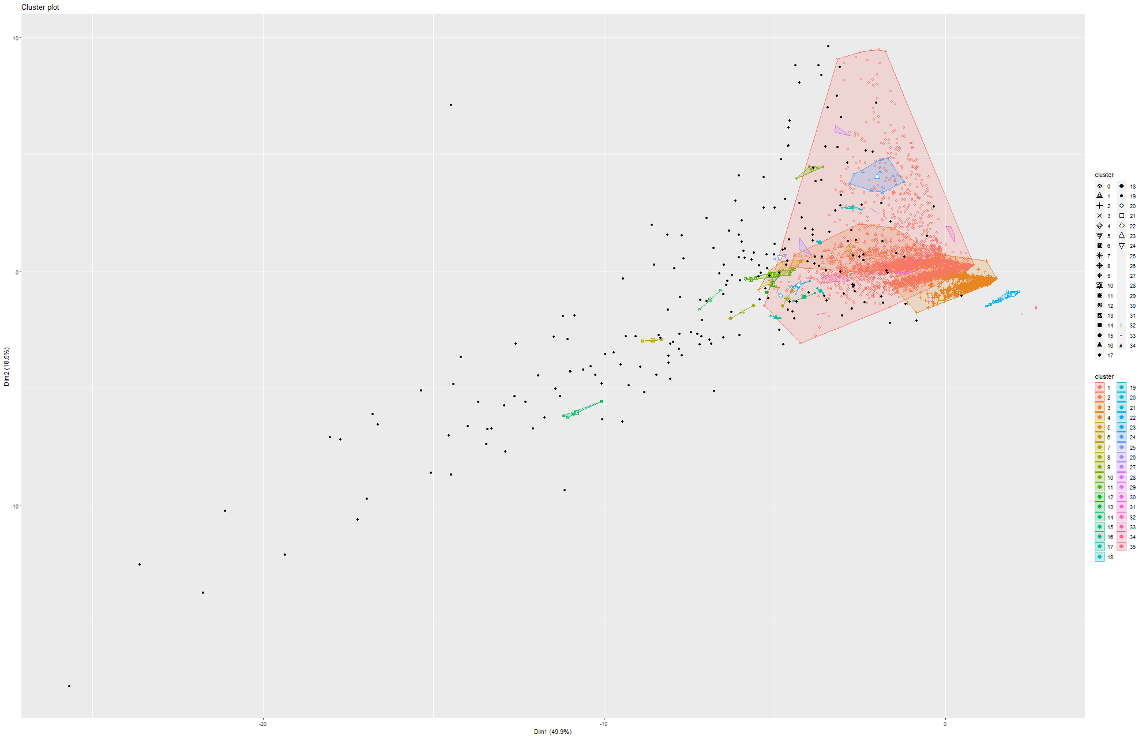
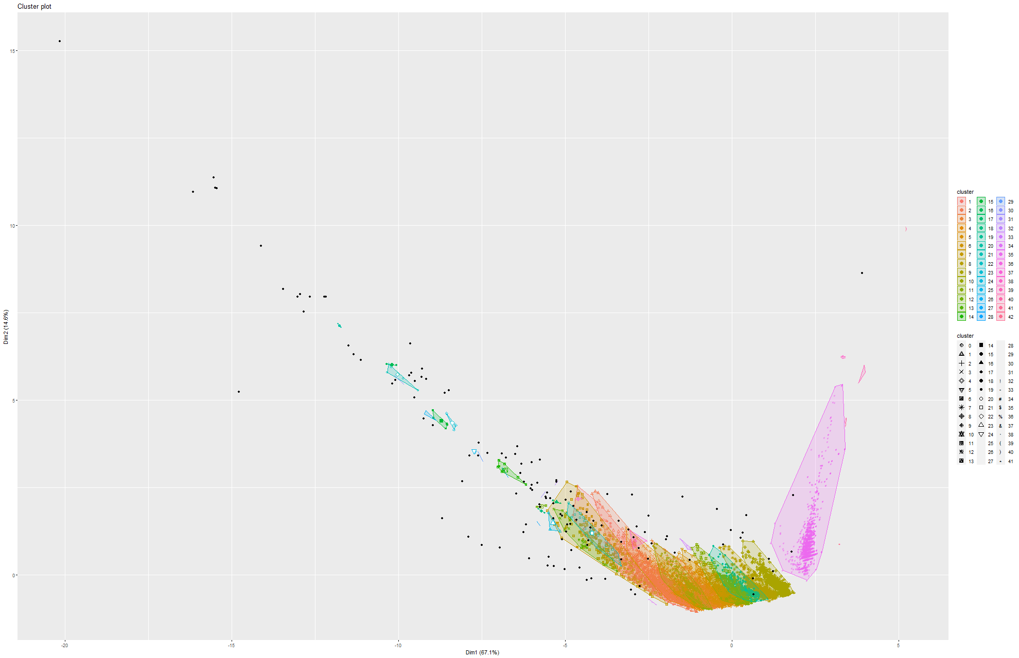
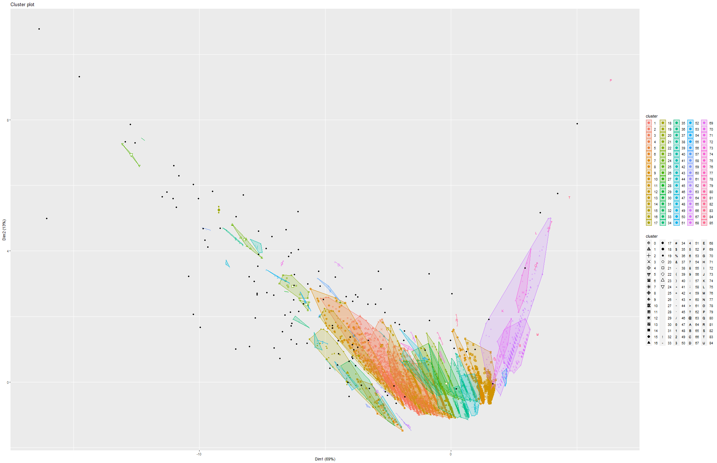
DBSCAN
PLOTS
Model 1
Model 2
Model 3
Model 4
Model 5
Model 6
Model 7
Model 8
Model 9

Slide 18
RESULTS
(on the ca-HepPH dataset)

Slide 19
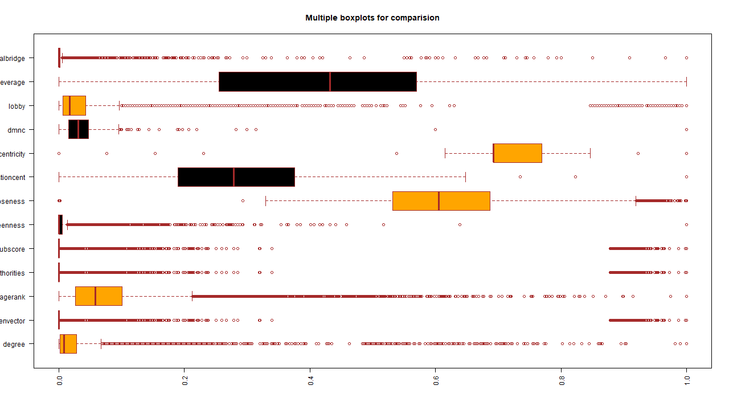
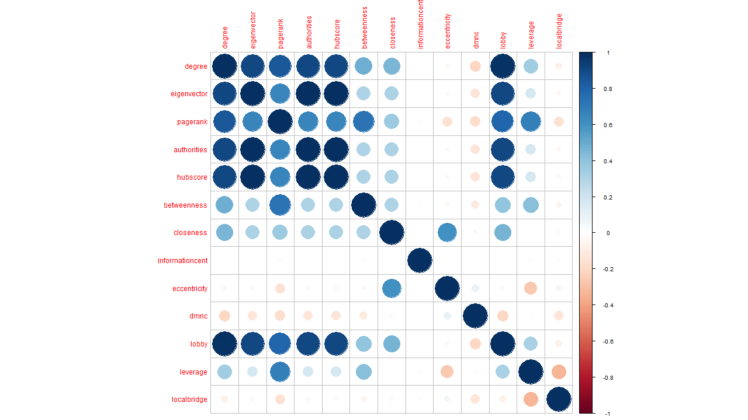
DATA
ANALYSIS
Boxplot
Correlation plot

Slide 20
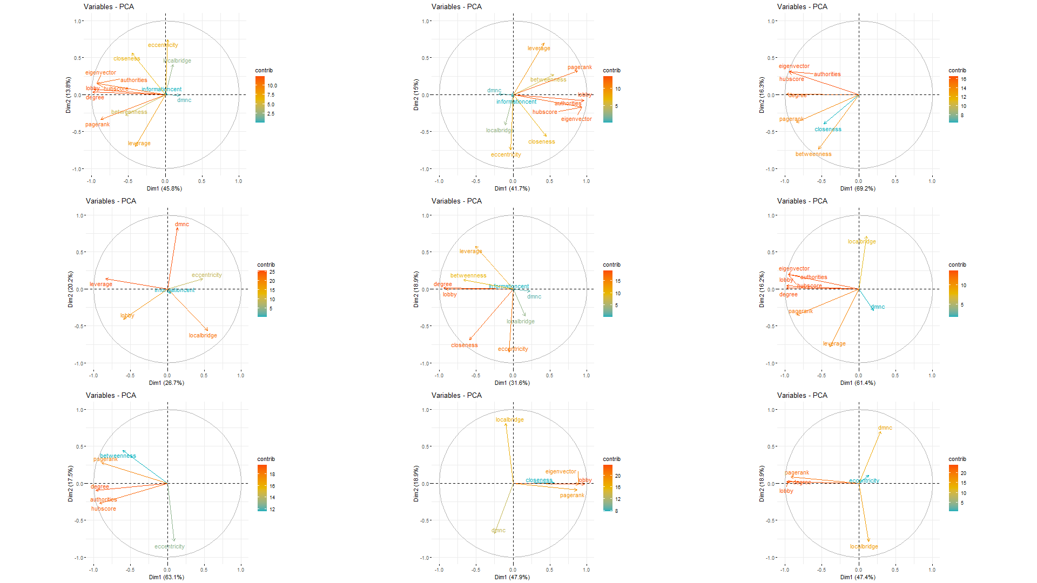
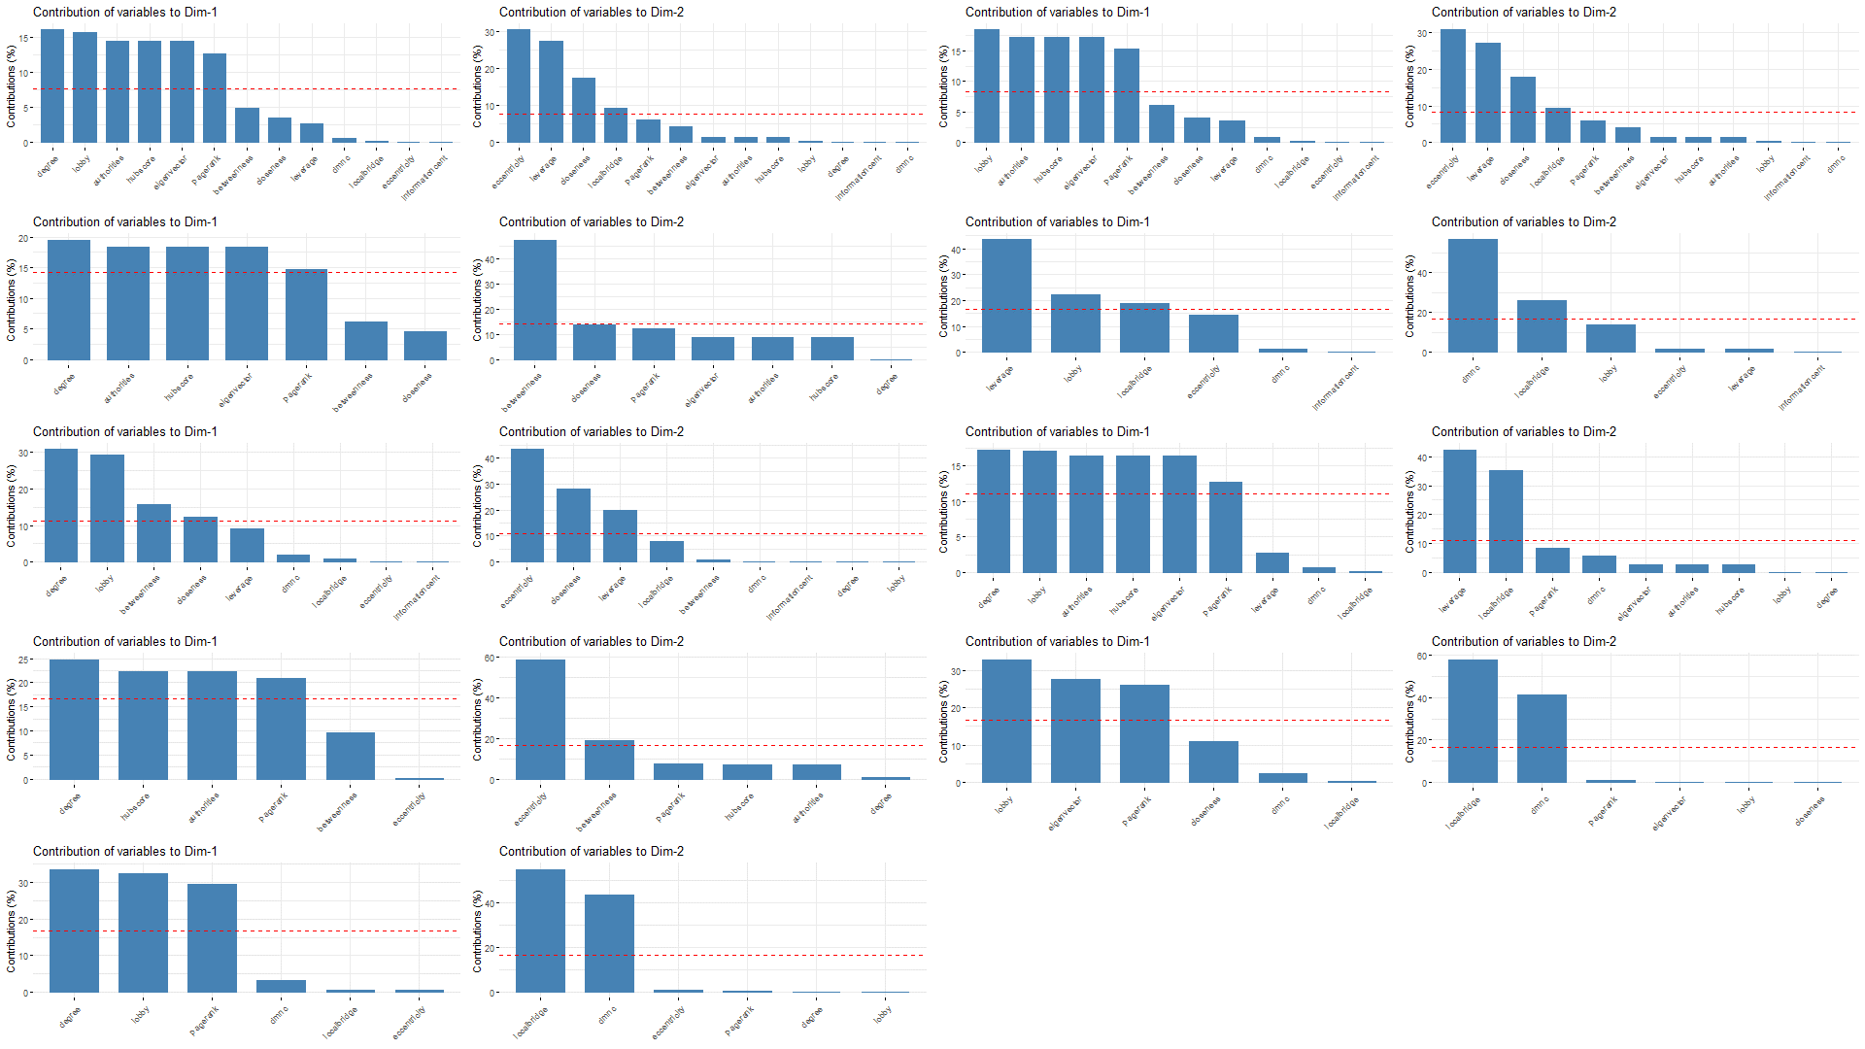
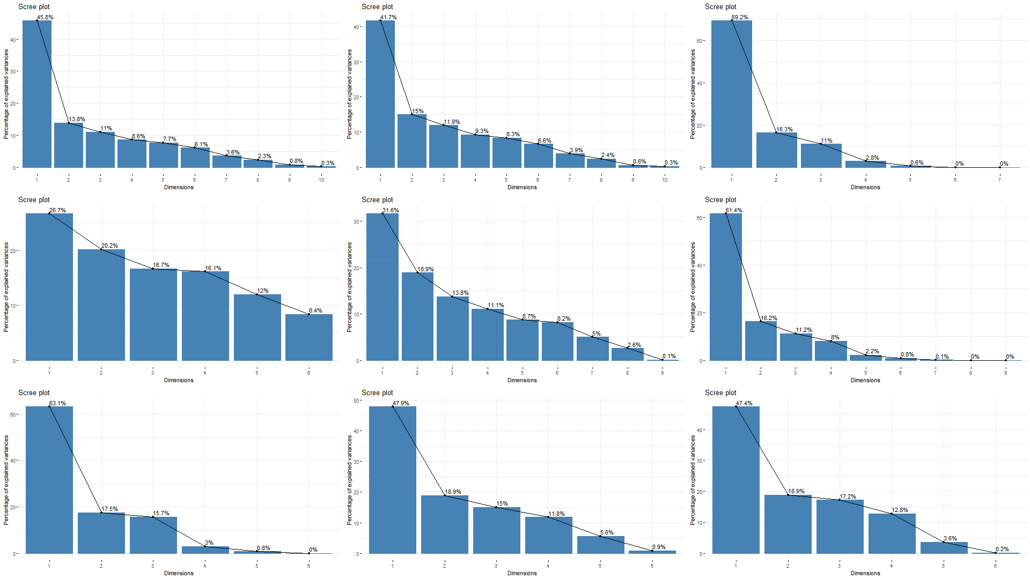

PCA
PLOTS
Cos2 Contribution
Dimension Contribution
Scree plot
Biplot

Slide 21









t-
S
N
E
P
L
O
T
S
(1st
M
O
D
E
L)
Model 1
Model 2
Model 3
Model 4
Model 5
Model 6
Model 7
Model 8
Model 9

Slide 22









UMAP
PLOTS
Model 1
Model 2
Model 3
Model 4
Model 5
Model 6
Model 7
Model 8
Model 9

Slide 23









SAMMON
MAP
PLOTS
Model 1
Model 2
Model 3
Model 4
Model 5
Model 6
Model 7
Model 8
Model 9

Slide 24









DBSCAN
PLOTS
Model 1
Model 2
Model 3
Model 4
Model 5
Model 6
Model 7
Model 8
Model 9

Slide 25
Conclusion
Based on our obtained results so far, we have found discriminatory visual aspects of different networks
Working on bigger datasets is extremely resource intensive, so that is a limitation we have faced
Hopefully we will have all the results within 2 weeks.

